Slide 1
VERP REDESIGN
VISION
IDEAS for BING NEWS

Slide 2
AGENDA
USER STUDY AND PAIN POINTS
COMPETITVE ANALYSIS
USER HABITS
DESIGN EXPLORATION

Slide 3
SECTION 1
USER STUDY AND PAIN POINTS
COMPETITVE ANALYSIS
USER HABITS
DESIGN EXPLORATION

Slide 4
User study and pain points
What DSATs told us
VISUAL TREATMENT:
want to bring back the list view, problem with image sizes, info density, etc.
CONTROL:
Want filtering, turning things off, customizing things, etc
INTERACTION RELATED:
Problem with infinite scrolling, placement of settings, etc.
Takeaway: fix content quality, don’t like the card view, want more control/filter/mute features

Slide 5
User study and pain points
What users told us about their behavior
“
I use search engines for news when I am looking for something specific, usually something I heard on social media.
What Research Tells Us About How People Engage with News (p15) – June 2018
VERP Baseline Study (p14) - Sep 2018
News: VERP Search + Clustered Model Design Review (p4)– October 2018
’’
News: Spotlight Comprehensive Design Study – (p4) – October 2018​
Takeaway: People use search engines to get more information on news they hear about elsewhere.

Slide 6
User study and pain points
What users told us about their behavior
What Research Tells Us About How People Engage with News (p15) – June 2018
Google News Review study, n= 48
Takeaway: Mobile is the primary device for consuming news.

Slide 7
User study and pain points
What users think of G News
Google organized the page so I don’t have to search very hard to find the top news or topics that interest me.
“
’’
VERP Baseline Study (p18-21) - Sep 2018
“
’’
News: VERP Search + Clustered Model Design Review (p4)– October 2018
Wow! This is great! Lots of good stuff and so easy to read!
Takeaway: people like organization, ease of use, content quality of Google News, although not necessarily beautiful.

Slide 8
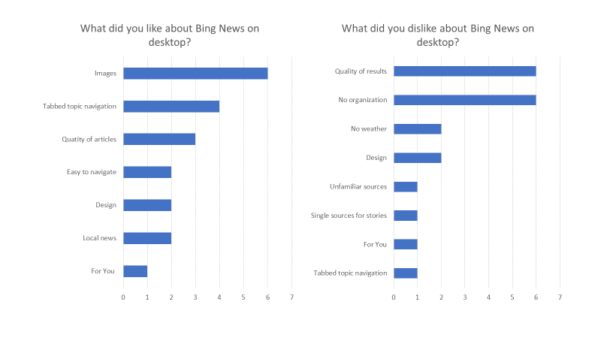
User study and pain points
What users think of Bing News Vertical
VERP Baseline Study (p45-47) - Sep 2018
Takeaway: people like images, layout, filters, but feel we lack of quality results and organization.

Slide 9
USER pain points
Problem Statement
INFORMATION OVERLOAD
Overwhelming and cluttered
IRRELEVANT
Distracting, Irrelevant content
DISORGANIZED
Random and disorganized, difficult to scan through the news
NOT PERSONALIZED
Hard to edit interests

Slide 10
SECTION 2
USER STUDY AND PAIN POINTS
COMPETITVE ANALYSIS
USER HABITS
DESIGN EXPLORATION

Slide 11
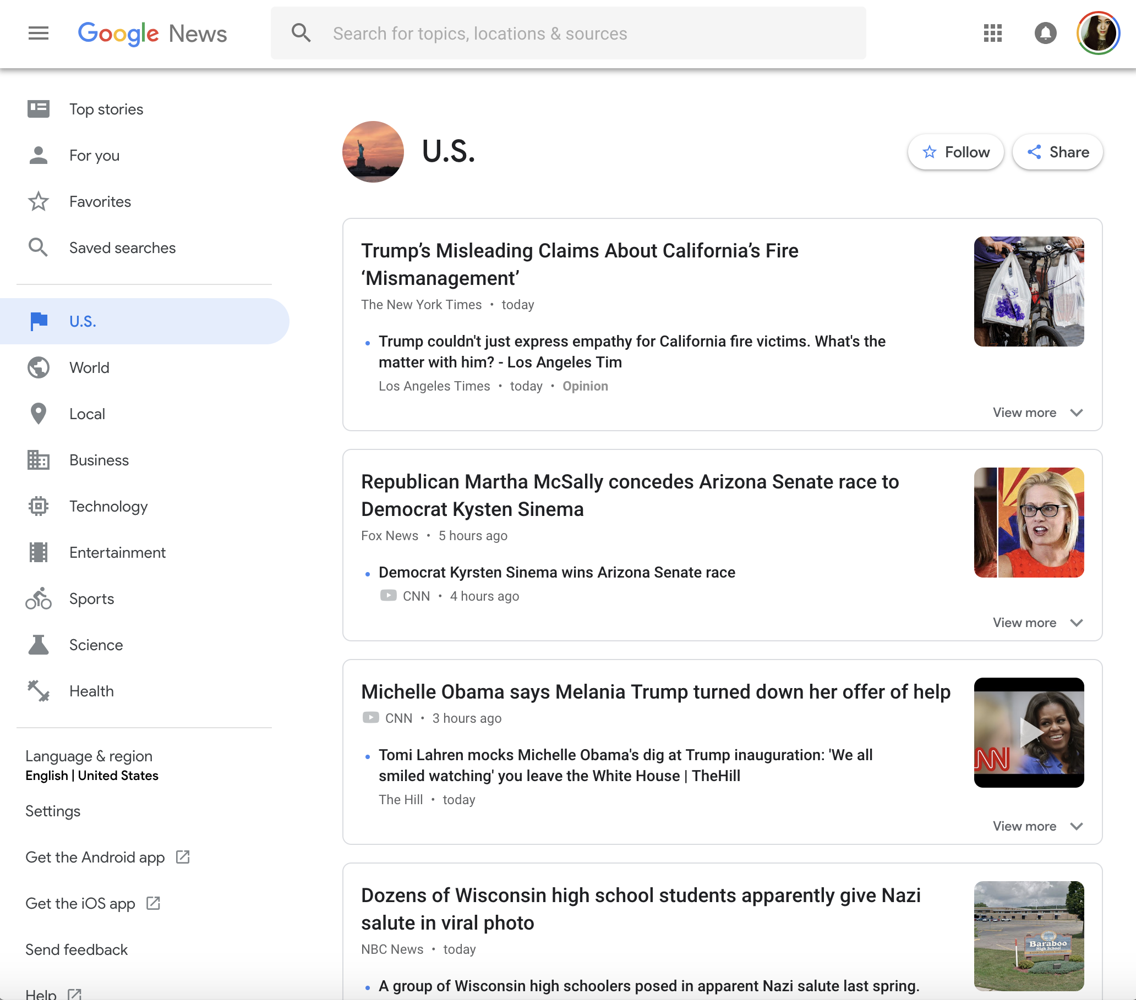
Competitive analysis
Design Trend
GOOGLE NEWS
Clean, minimal, daily briefing, interests, local stories

Slide 12
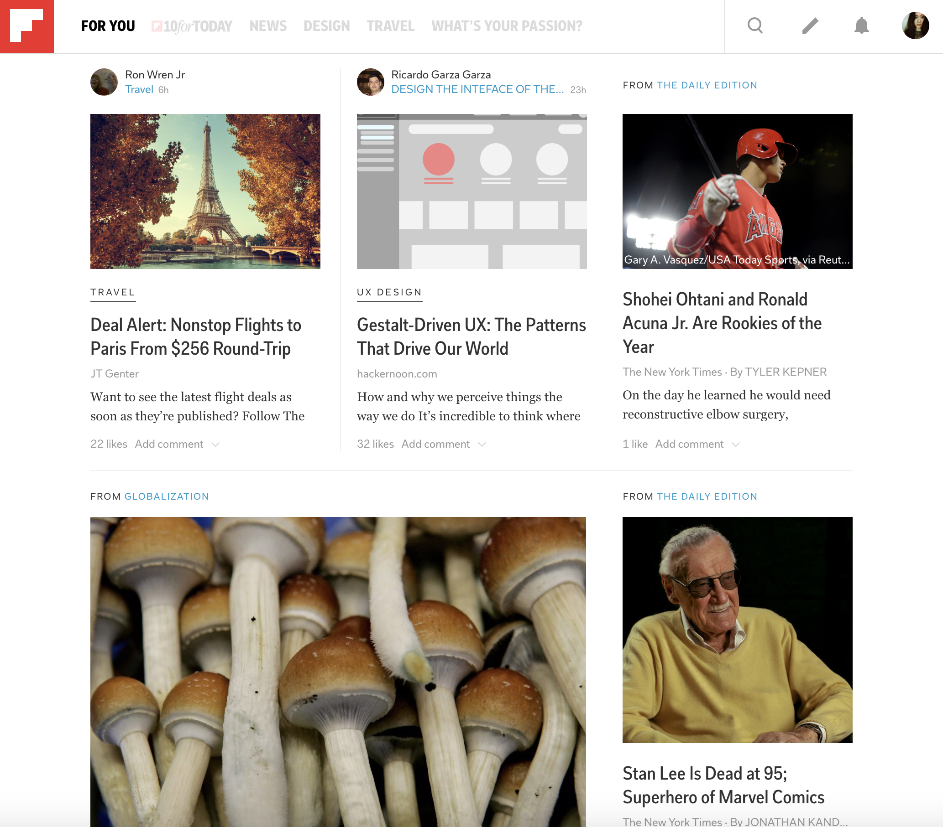
Competitive analysis
Design Trend
flipboard
Flipping, bold font, interests, recommendations, more stories

Slide 13
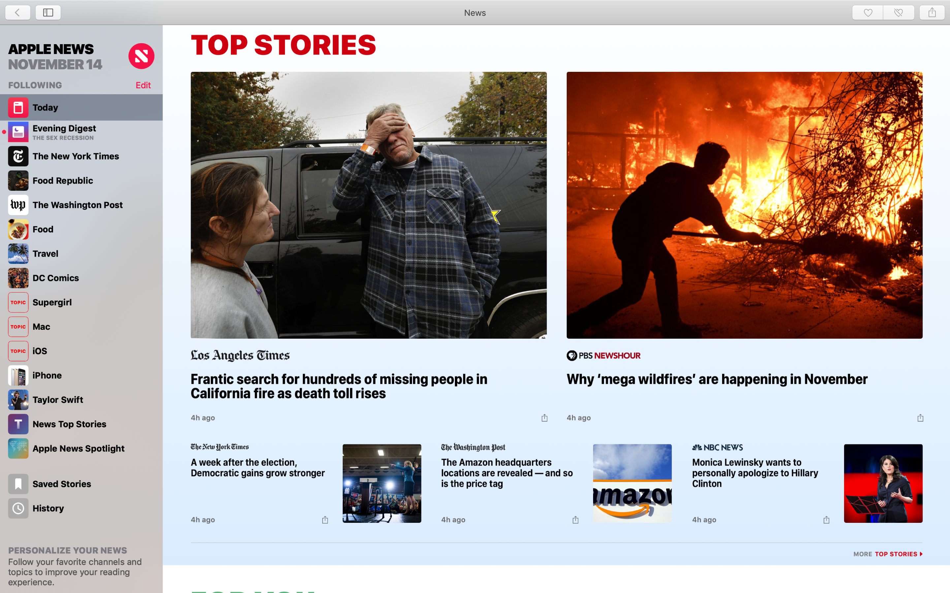
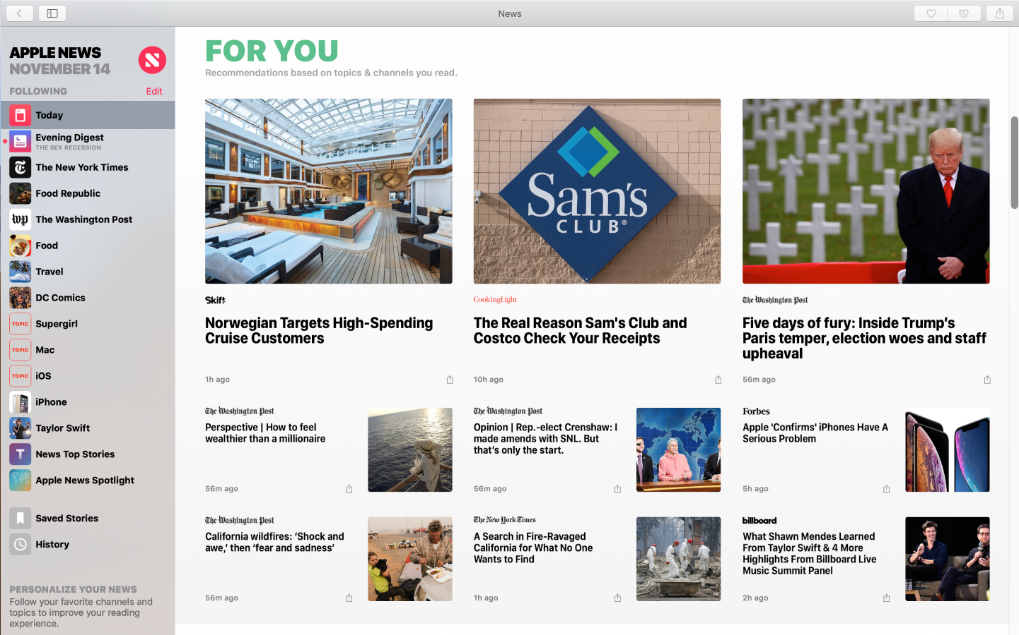
Competitive analysis
Design Trend
APPLE
Colorful, big bold fonts, top stories, trending, featured, videos

Slide 14
Competitive analysis
Design Trend Statement
CONTENT-CENTERED EXPERIENCES
\ Having a clear order with how visuals are presented to make content comprehension easier
\ Removing unnecessary “design clutter” to keep the attention focused on product content
\ Making good use of white space to give content some breathing room
TIME-SAVING DESIGN
\ Designing with common user navigation patterns in mind
\ Context-specific features (only visible when users are only to need them)
\ Simple navigation
INCLUSIVE DESIGN
\ content appropriateness/accessibility/ease of use for everyone
\ incorporating user study/creating a diverse design team

Slide 15
SECTION 3
USER STUDY AND PAIN POINTS
COMPETITVE ANALYSIS
USER HABITS
DESIGN EXPLORATION

Slide 16
USER HABITS
Scenario: A day in the life of a news consumer
 |  | Morning fix of strong coffee and headlines news after getting up
​ |  | Read trending news during coffee break Read personalized feed at lunch Read breaking news through notification​
 |  | Read/Listen news before go to sleep​ Read and search news at commute​ Read breaking news through notification​
TIME
DEVICE
SCENARIO
Morning at home/commute
​
Mobile/Car​
​
Day time at work
Lunch time at work​
​
Desktop/Mobile​
Evening at home​
​
Desktop/Mobile/Speaker​
​

Slide 17
USER HABITS
Scenario: A day in the life of a news consumer
Time​ | Surface​ | Scenario​
Morning at home | Mobile​ | Read/Listen daily digest after get up​
Day time at work​ | Desktop​ | Read trending news at beginning of the work time​ Read personalized feed at beginning of the work time​ Read and search news at coffee break​ Read breaking news through notification​
Evening at home​ | Mobile​ | Read/Listen news before go to sleep​ Read and search news at commute​ Read news while receive the notification in social place (bar/restaurant)​
SEARCH
EXPLORE
BROWSE
CONSUME

Slide 18
USER HABITS
Scenarios: How do you seek news?
HOW PEOPLE GET NEWS
HOW PEOPLE DECIDE WHAT TO READ
HOW PEOPLE READ STORIES
WHAT PEOPLE DO AFTER READING
SCENARIOS
OPPORTUNITIES
SCENARIOS
OPPORTUNITIES
SCENARIOS
OPPORTUNITIES
SCENARIOS
OPPORTUNITIES
Traditional channels ( TV, news publisher sites, etc. )
Publishing platform?
Browse
Information hierarchy
UX clarity/ease of use
Interest
Better organization of content
Article labels
Skim/get a overview
Skim headlines
Watch videos
Flip through images
Bite-size story format
Fast facts
Summary
QnA
Continue to explore
Seek similar topics
Acquire more knowledge
Better topics for exploration
Easier way to explore
Search for the event/topic
Event inference
Collaborate with Project Metis
News portal
Homepage
News vertical
Opal
Feed app
MSN
Daily briefing
Optimization on columns and sections on VERP
Decide
Relevancy
Freshness
Quality
Trustworthiness
Importance
Visual impact
More trust indication
More local source content
Publisher pane
Editorial picks
Paywall indicator
Deep dive
Read article and related coverage
Do research
Spotlight experience + multiple perspectives
Perspectives in news answer
People relationships
More immersive and engaging UX: images, visual topics (slideshow news) in verp
Take actions
Share on social media
Comment
Save for later
Talk about it
Better action framework to share and save
Emotional design to let them come back for more
Social network
Facebook
Twitter
Reddit
Bing news social account
Inclusion of Reddit content in news answer
Most shared article on Twitter
People around
Direct URL
More share actions
WE GOT IT COVERED
TRUSETD, WELL-STRUCTURED, EFFICIENT, KNOWS YOU
COMPREHENSIVE, ENGAGING
HABIT FORMING

Slide 19
USER motivation
How our design can help users?
SAVE TIME
More efficient and engaging way to get informed
DIG DEEP
Comprehensive, perspectives, and trusted sources
EXPLORE MORE
More extensive exploration/better understanding of interests

Slide 20
From latest research
PRIORITIES
Fix: Improve organization/navigation
Double down: visuals/imagery

Slide 21
BING NEWS SHOULD BE

Slide 22
DESIGN Approach
DESIGN FOR EFFICIENCY
Better layout, fast and easy to read, more control.
DESIGN FOR TRUST
Better organization, cluster, clear structure
DESIGN FOR SIMPLICITY
Focused, modern, clean and simple.

Slide 23
SECTION 4
USER STUDY AND PAIN POINTS
COMPETITVE ANALYSIS
USER HABITS
DESIGN EXPLORATION

Slide 24
DESIGN
EXPLORATION

Slide 25
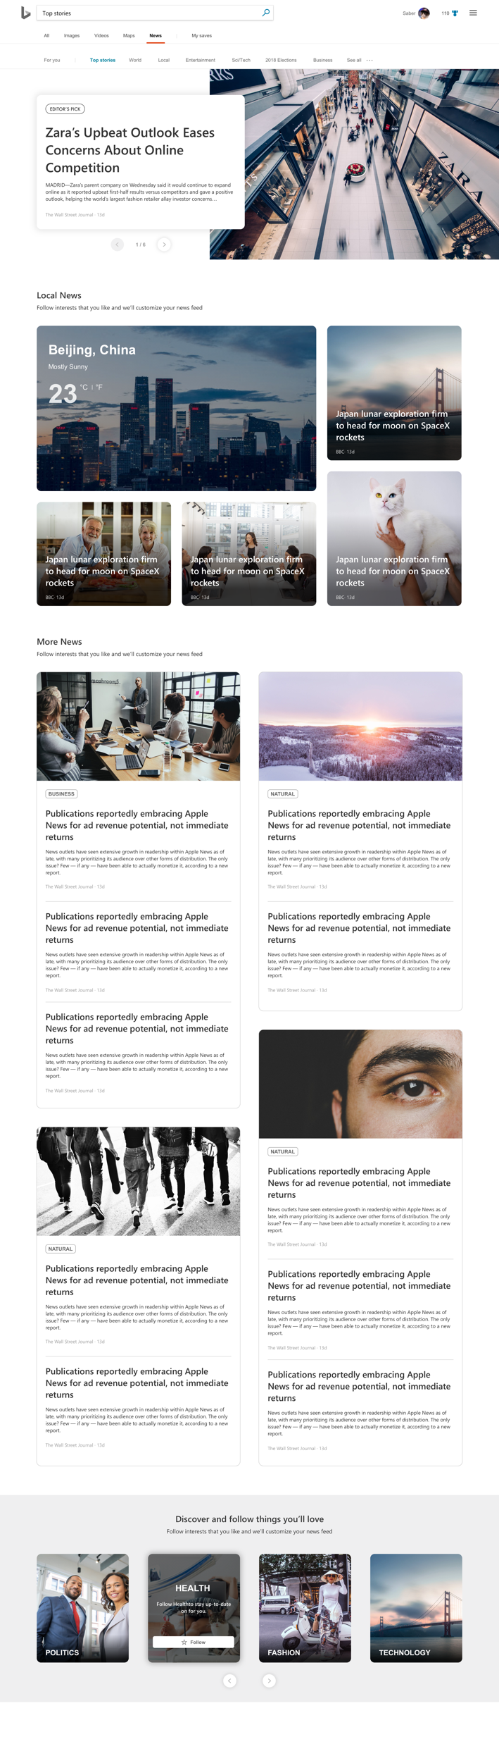
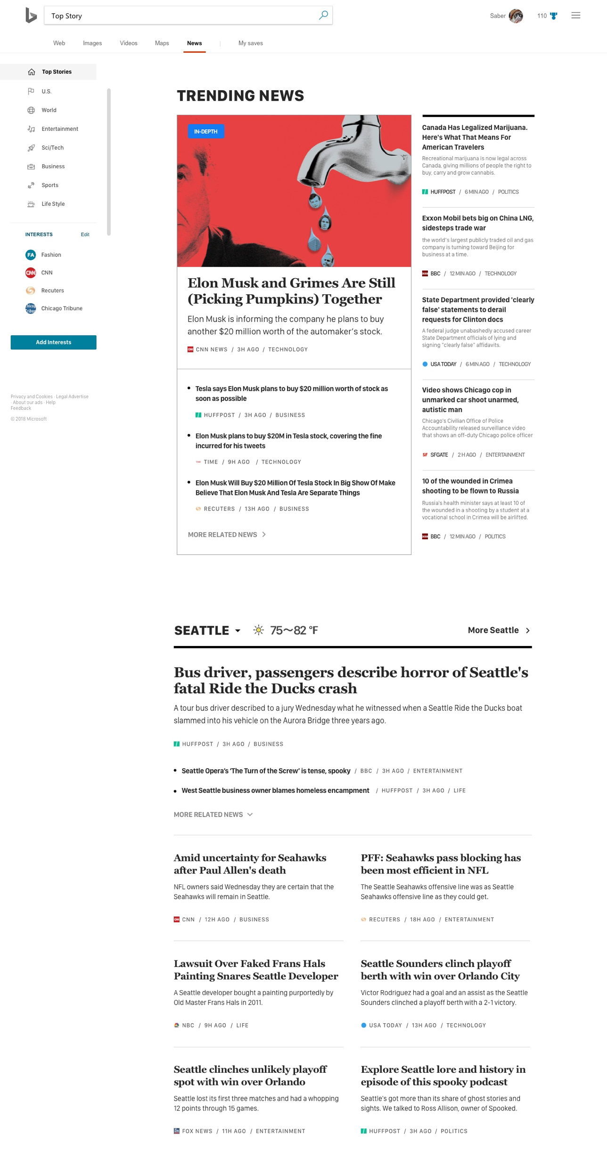
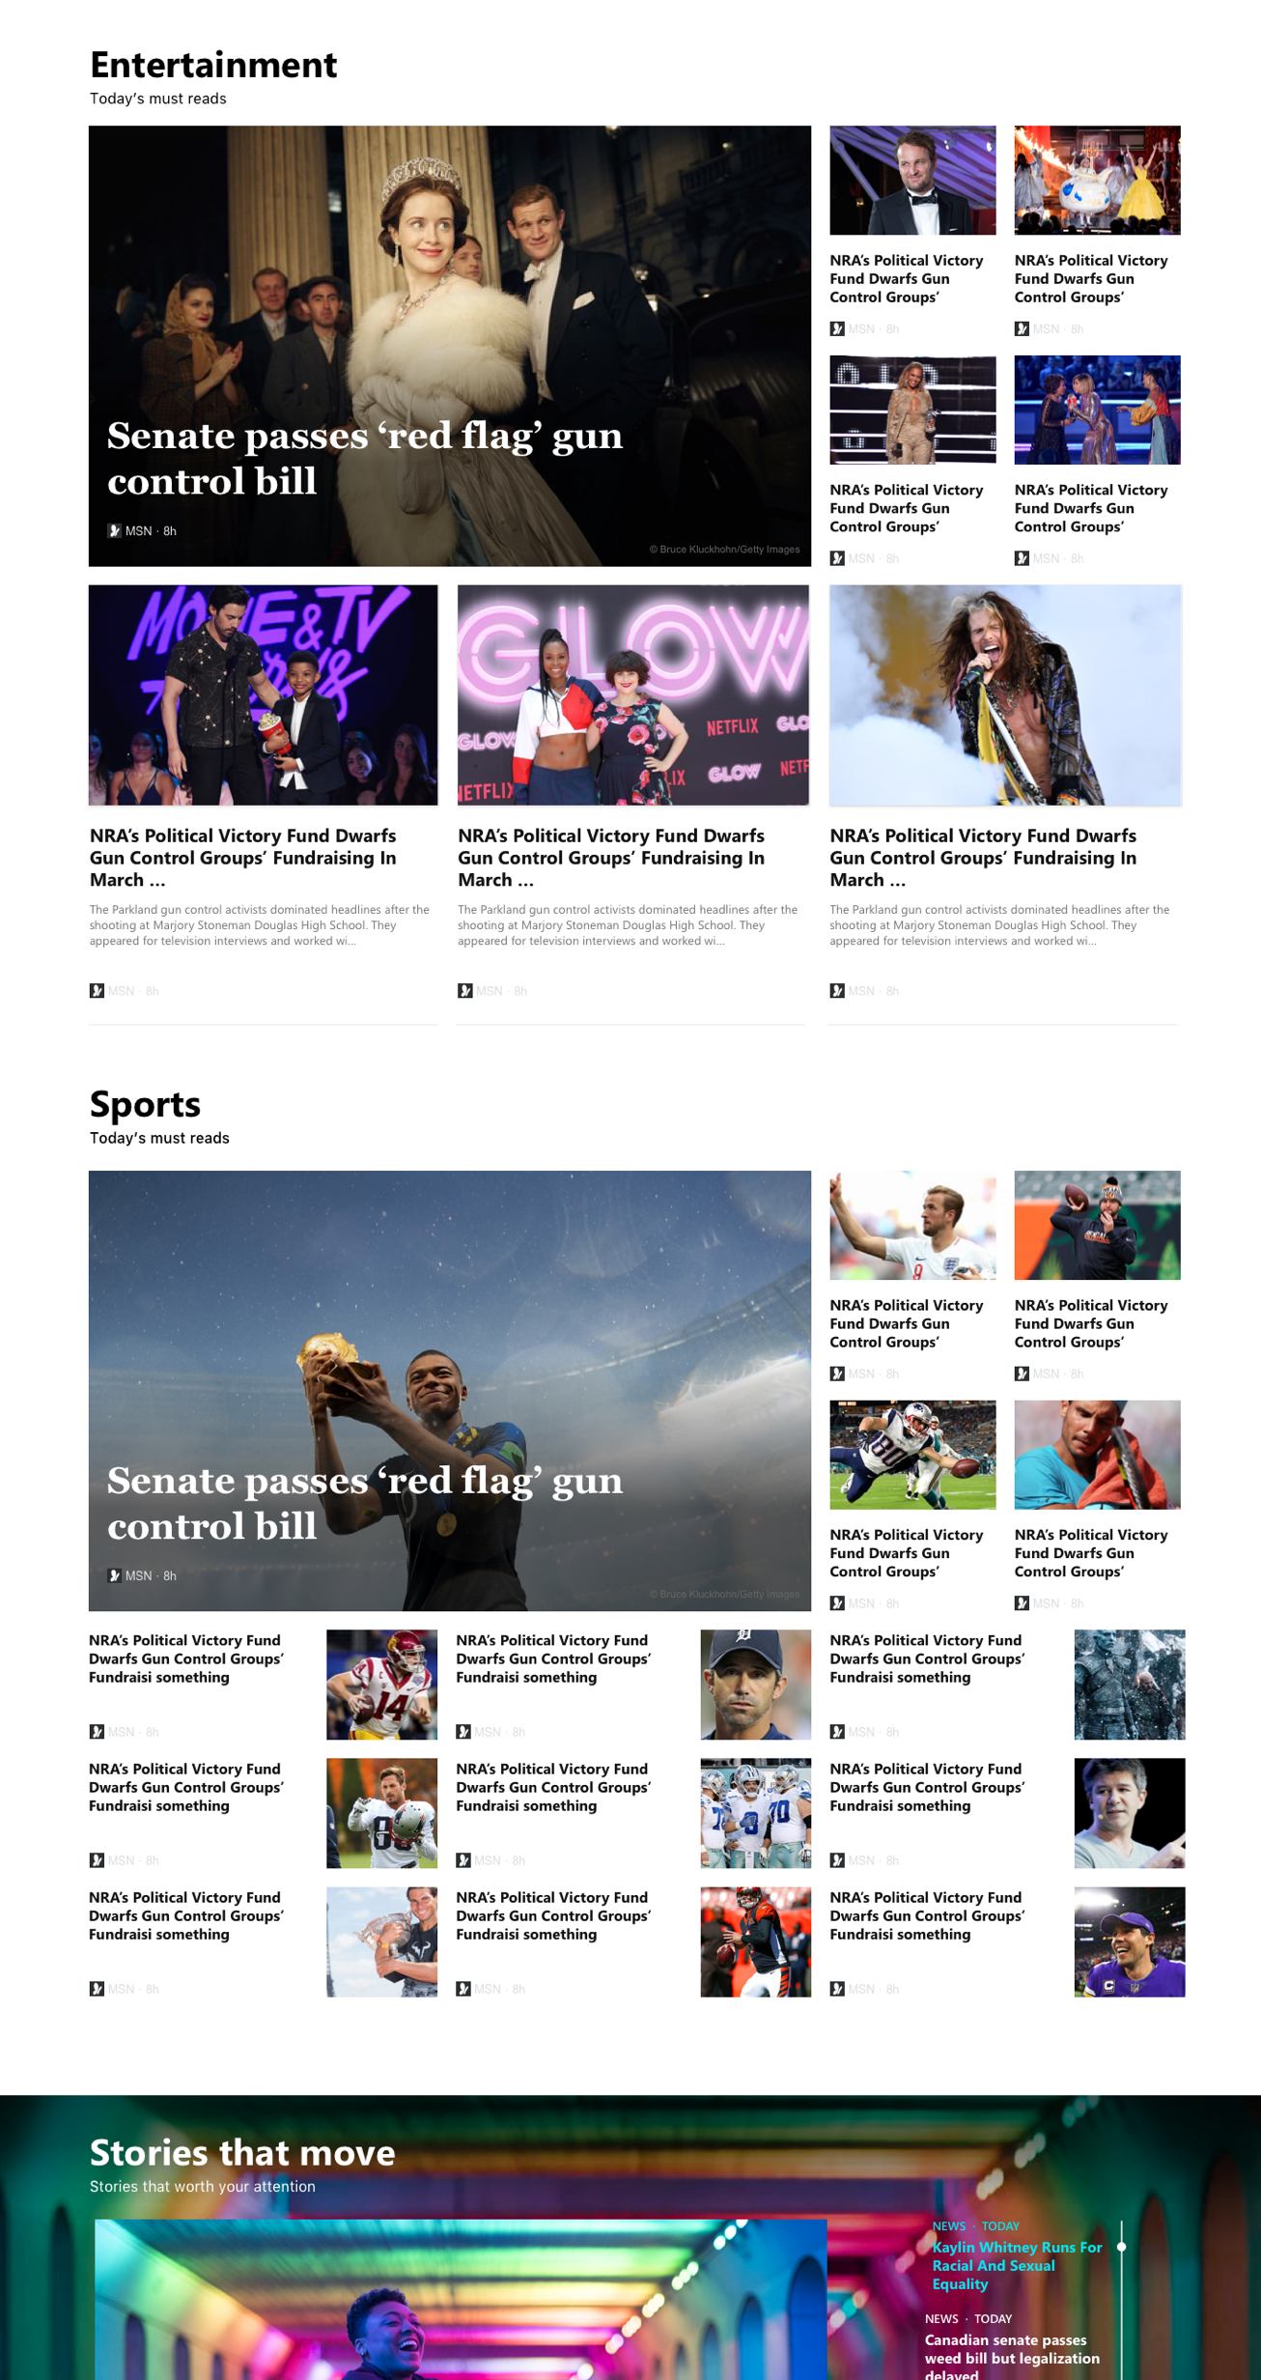
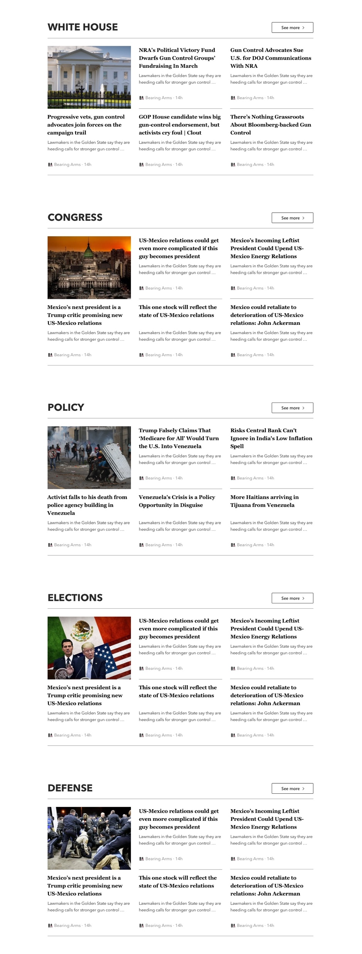
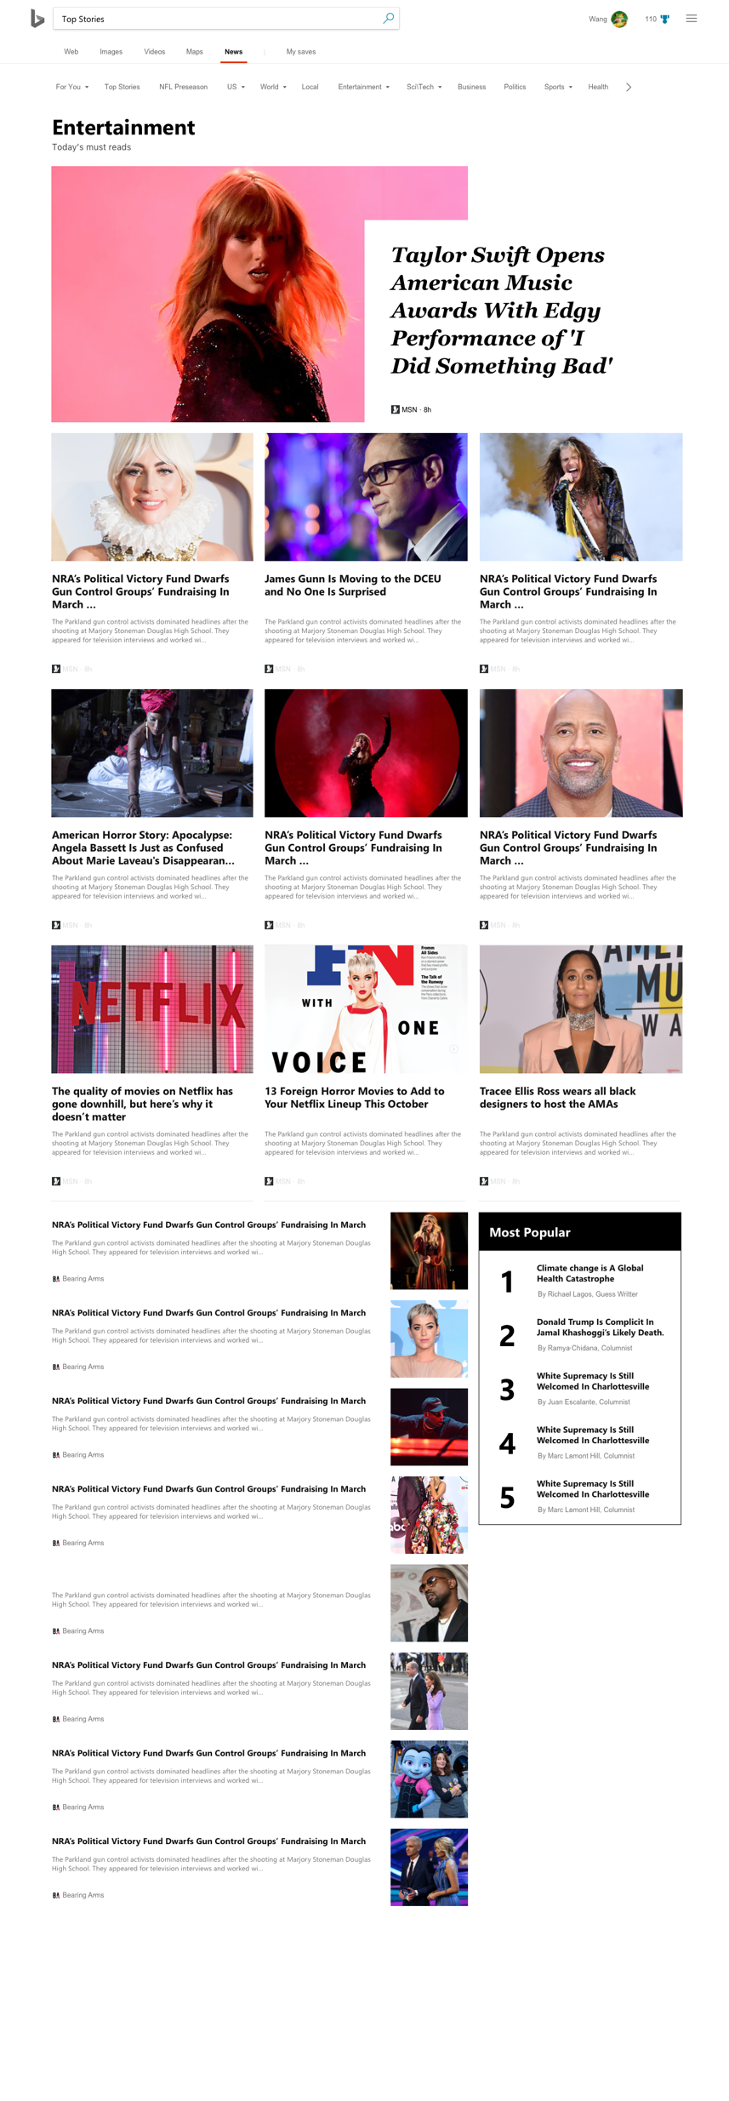
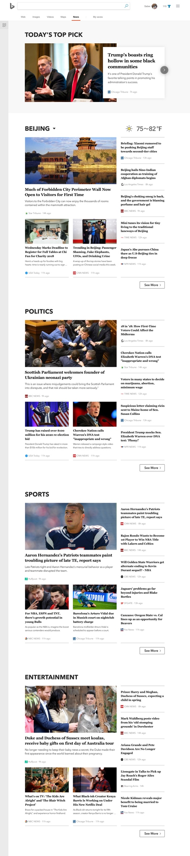
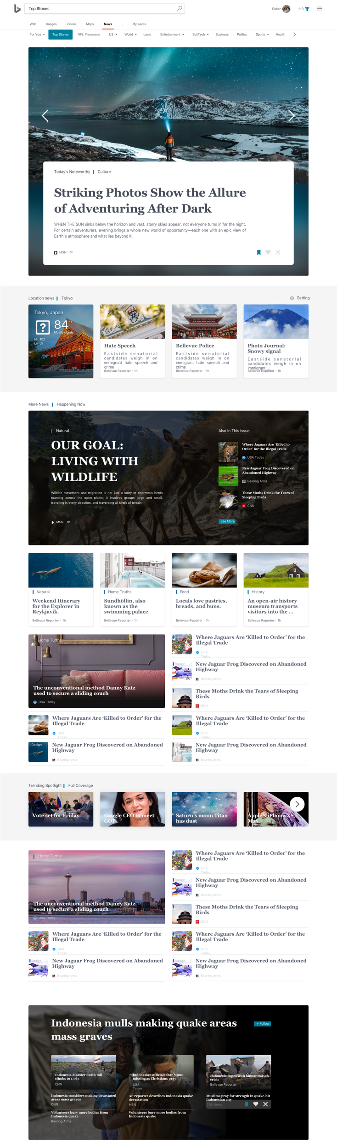
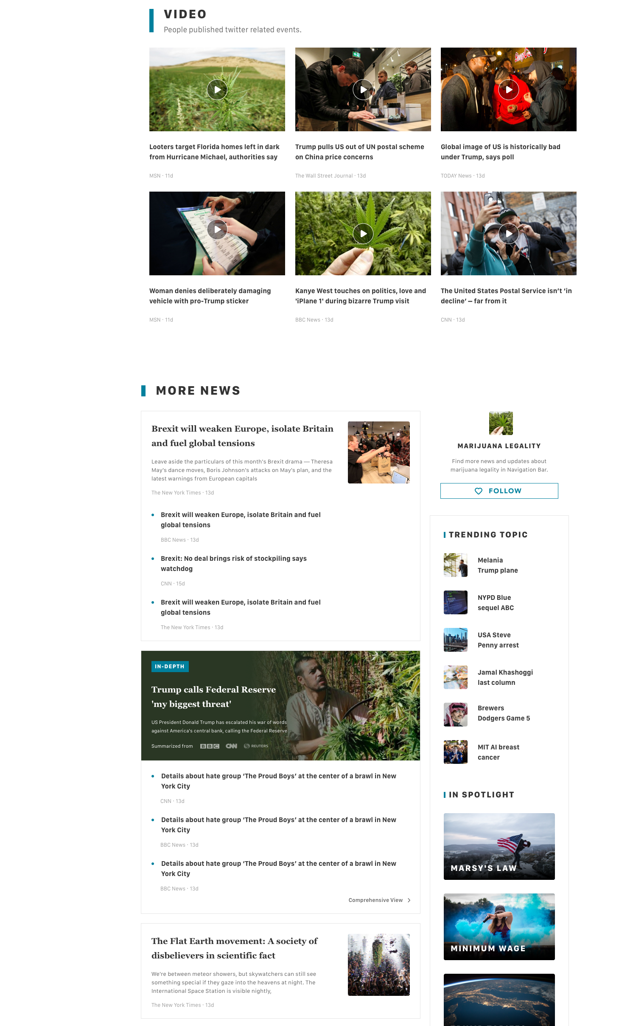
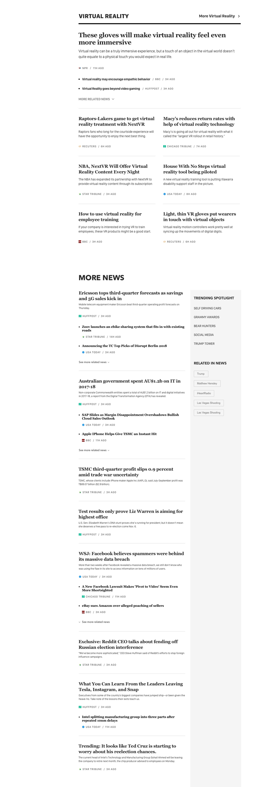
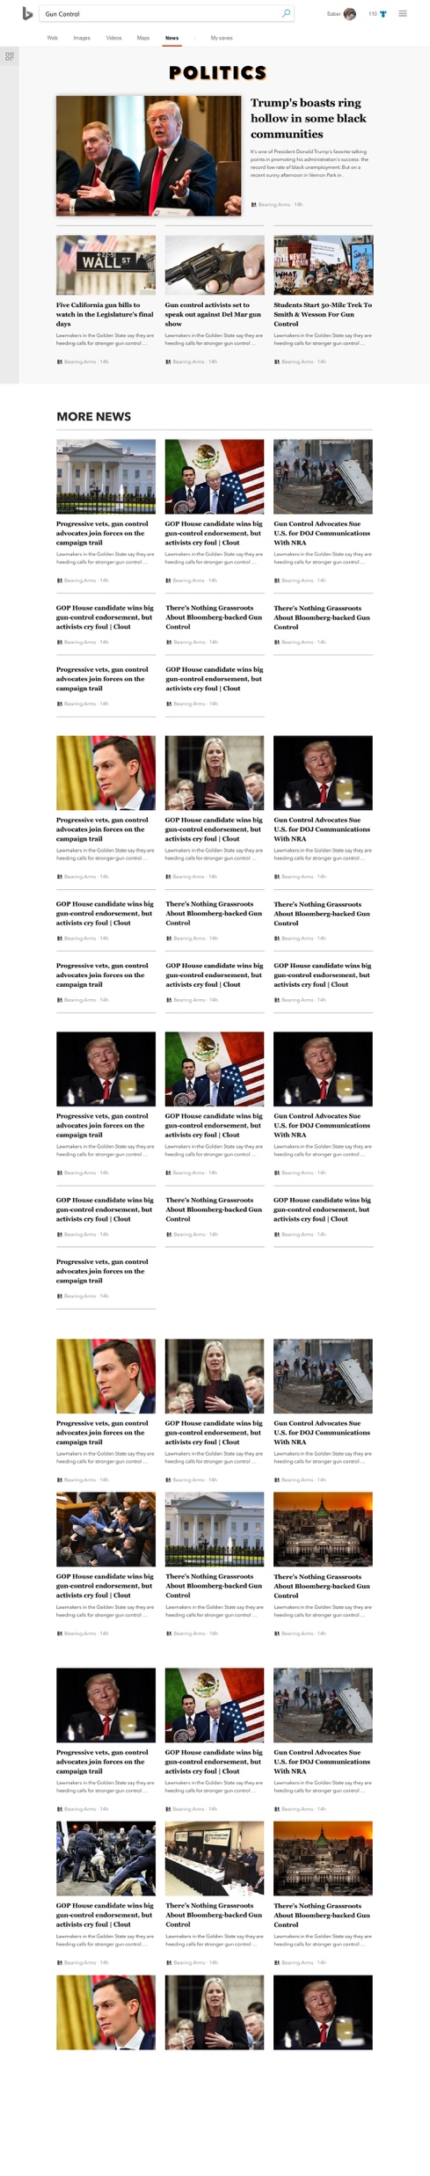
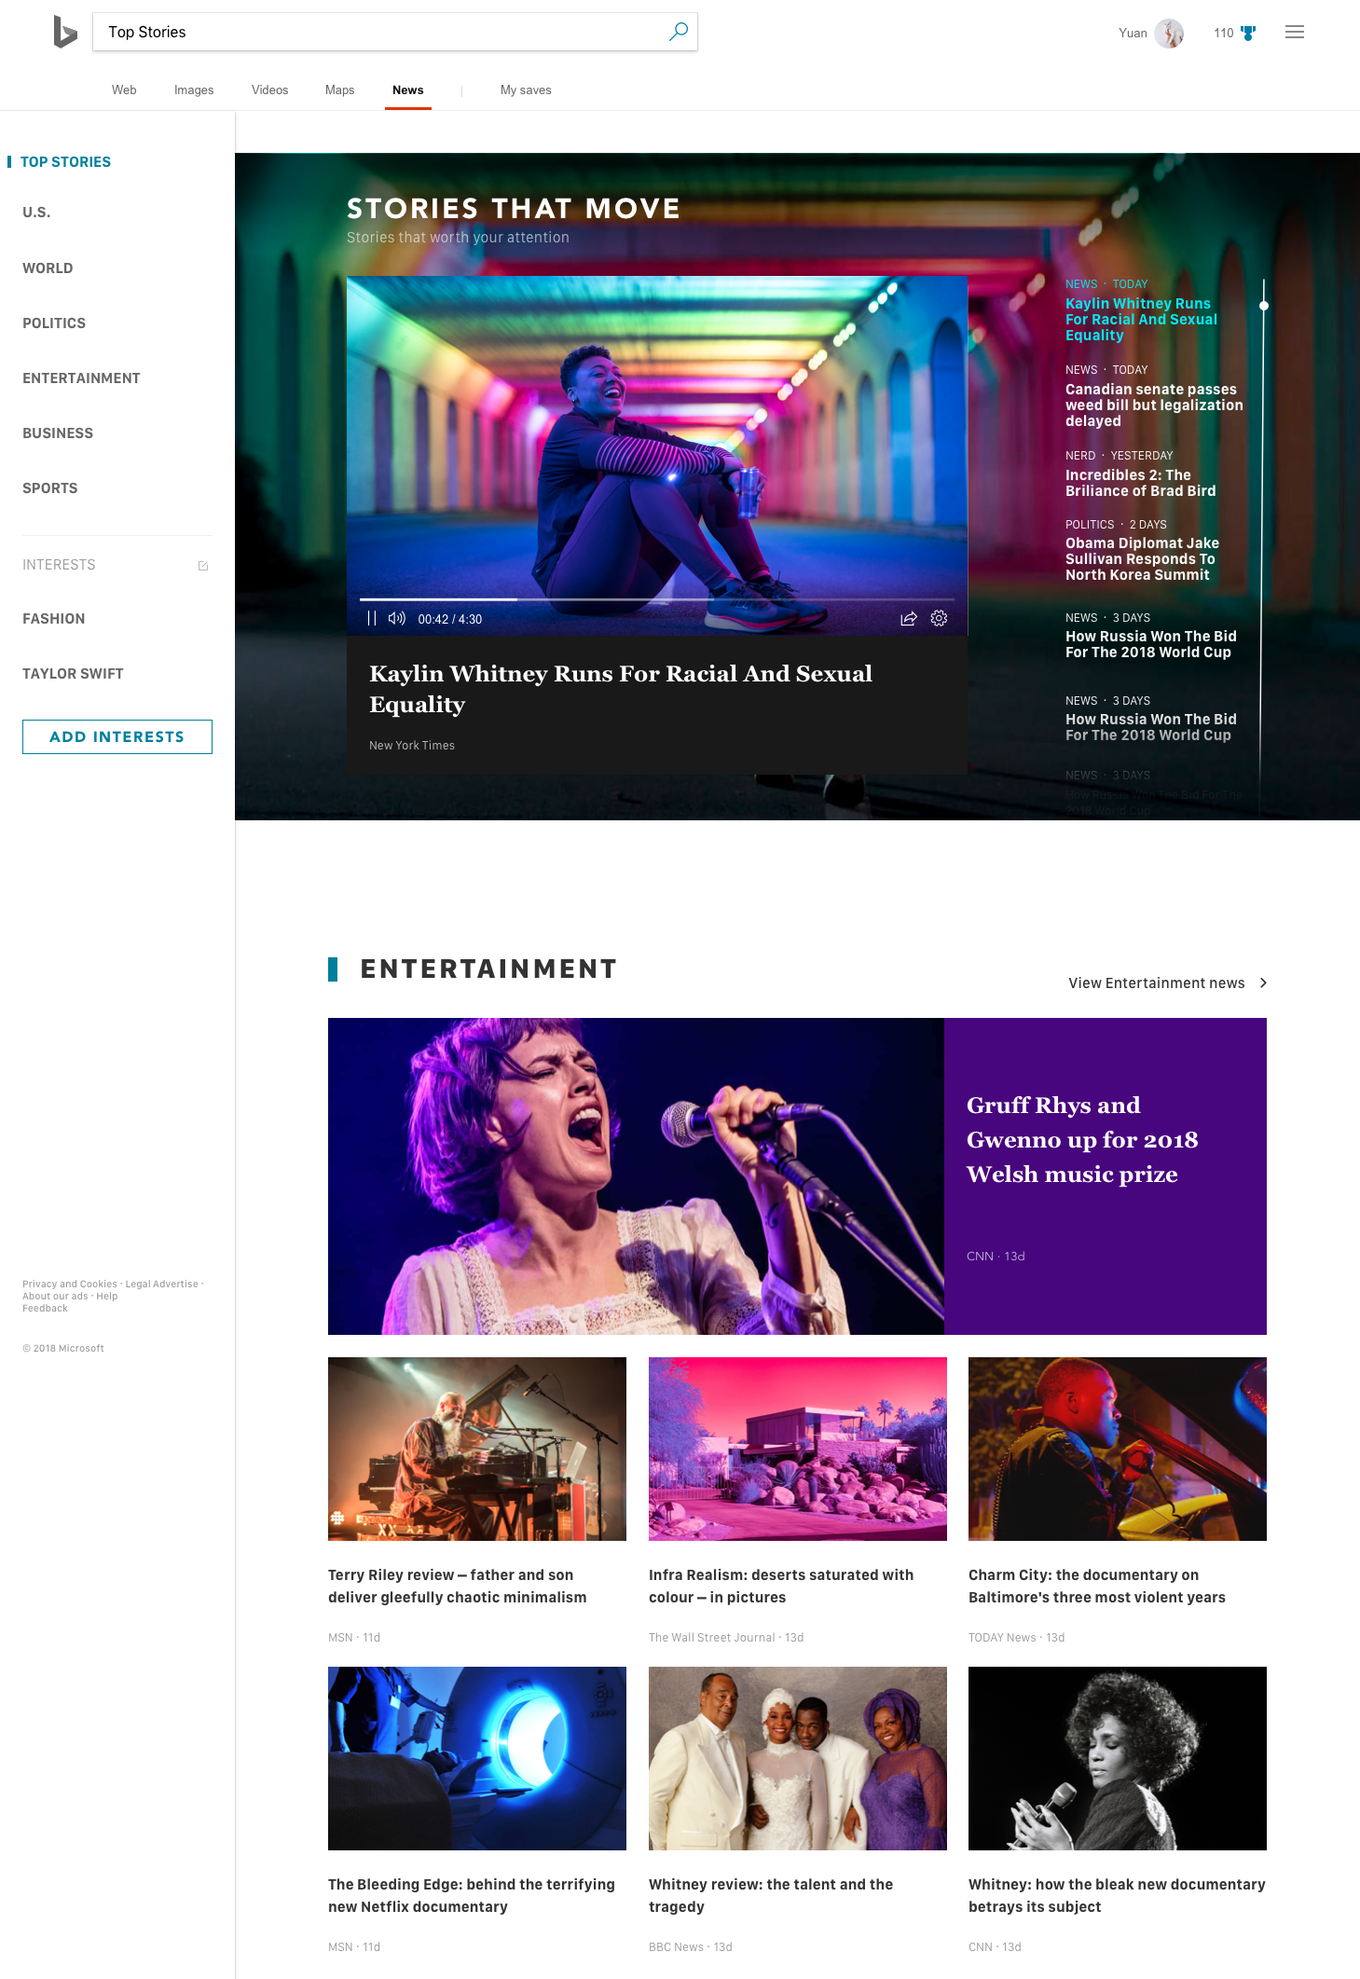
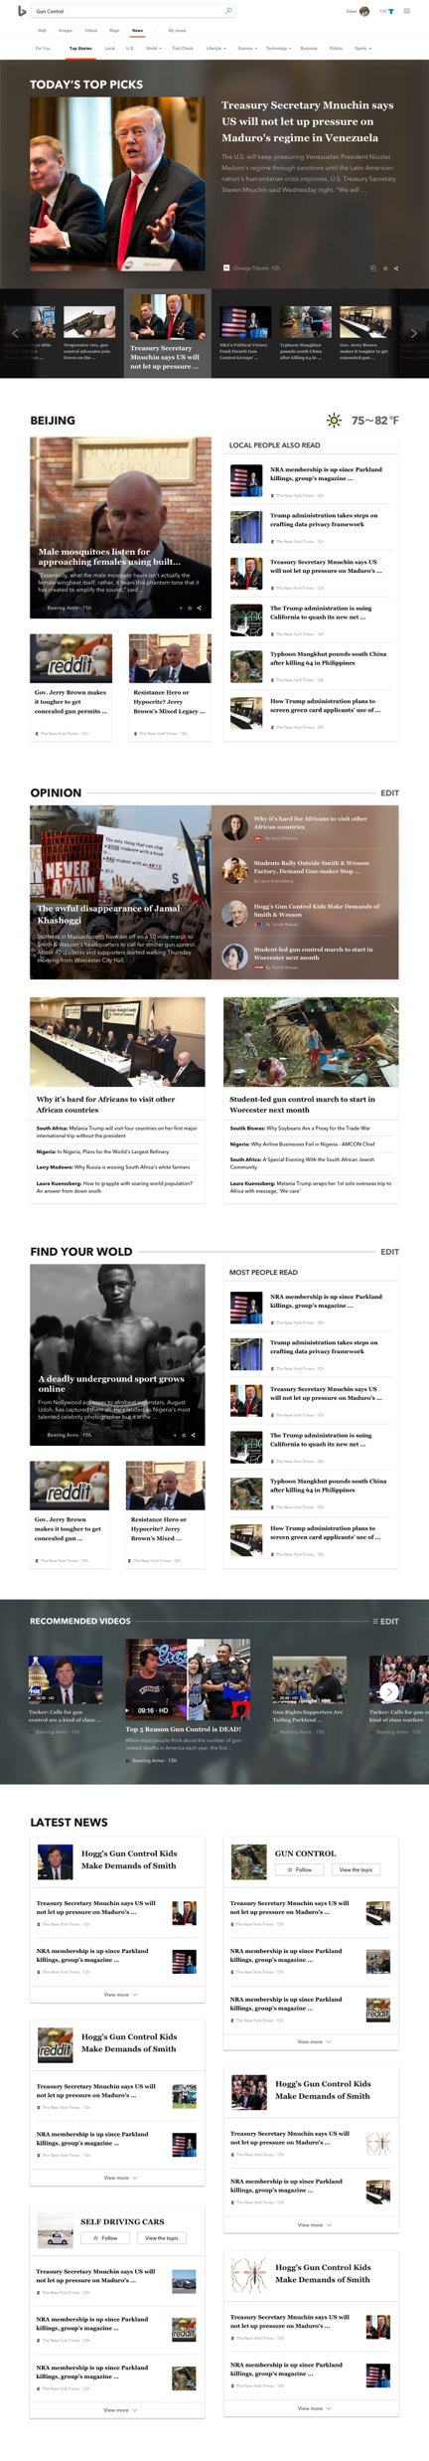

Slide 26
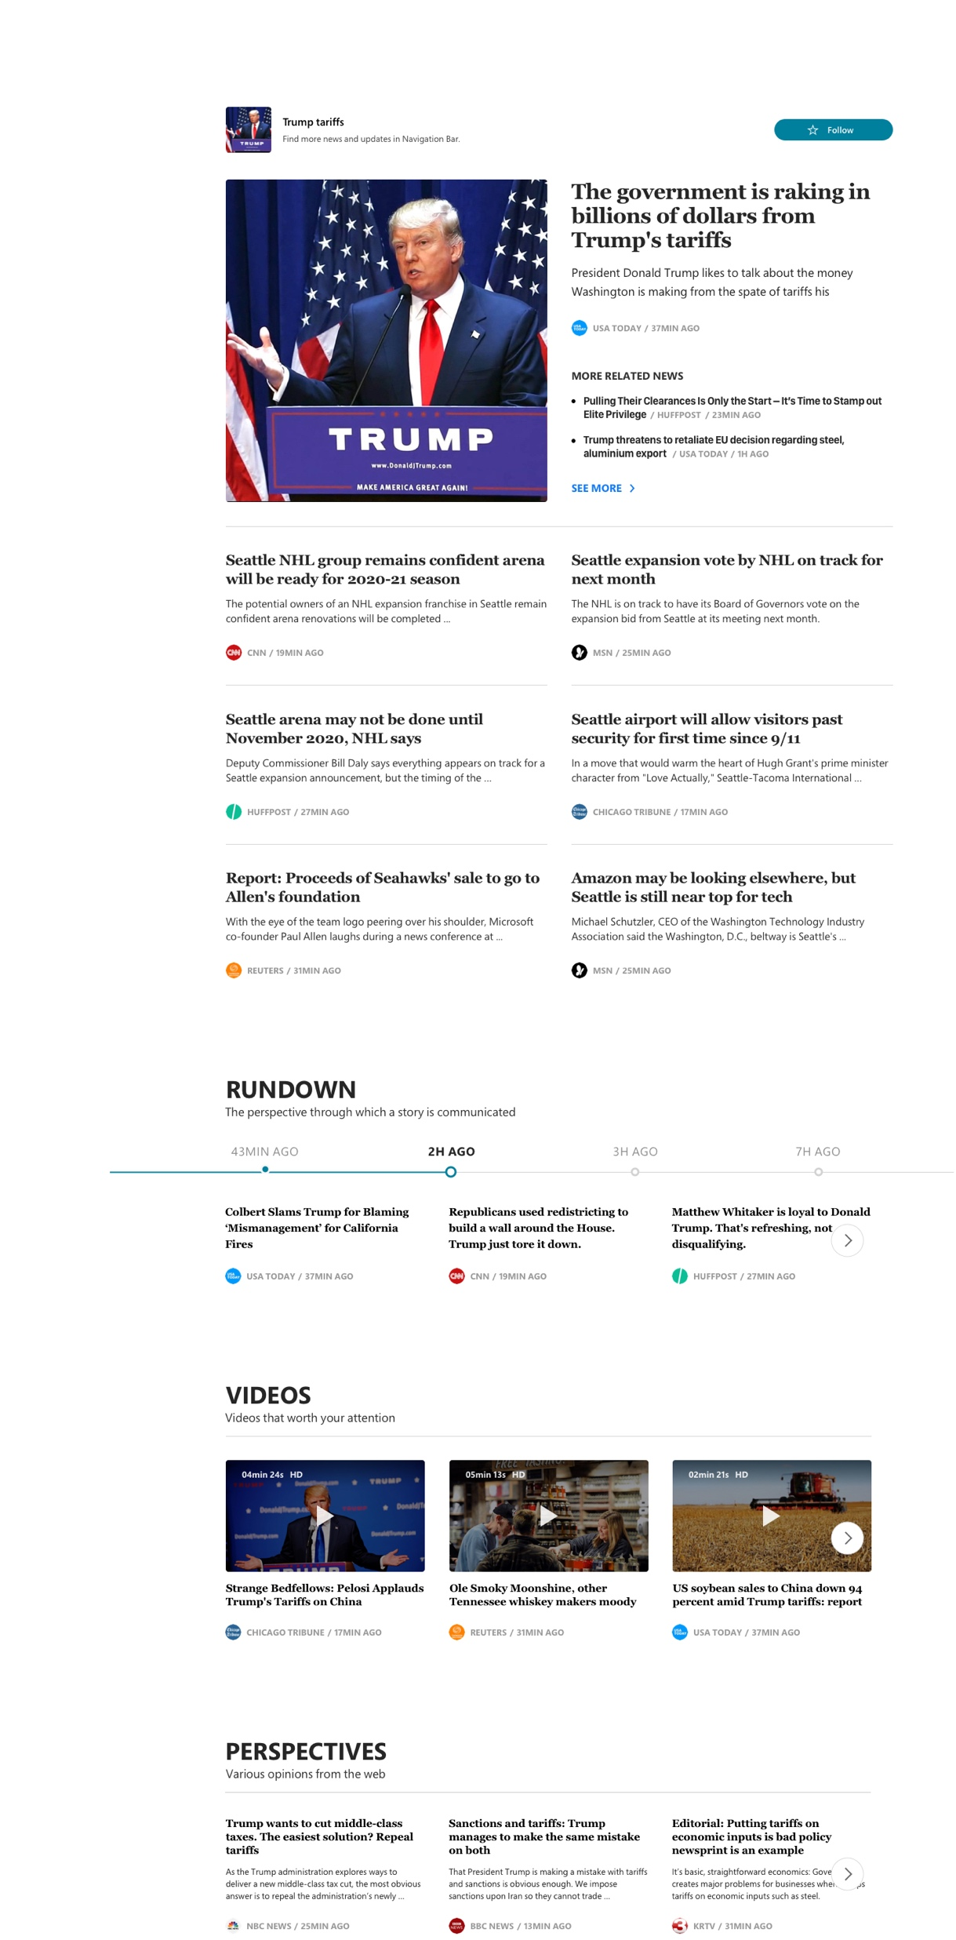
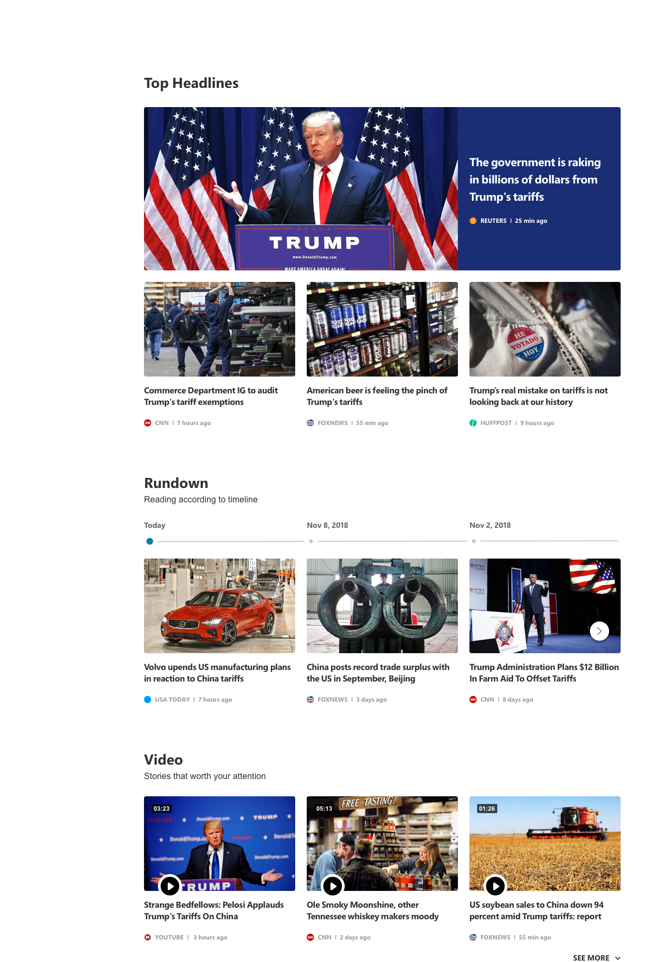
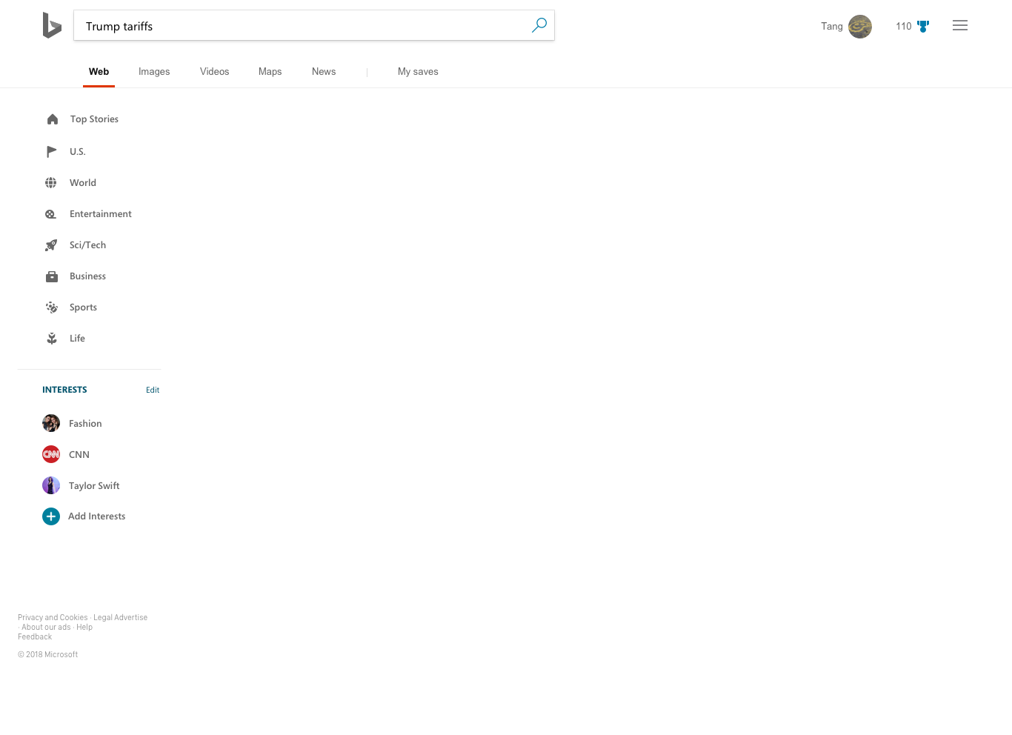
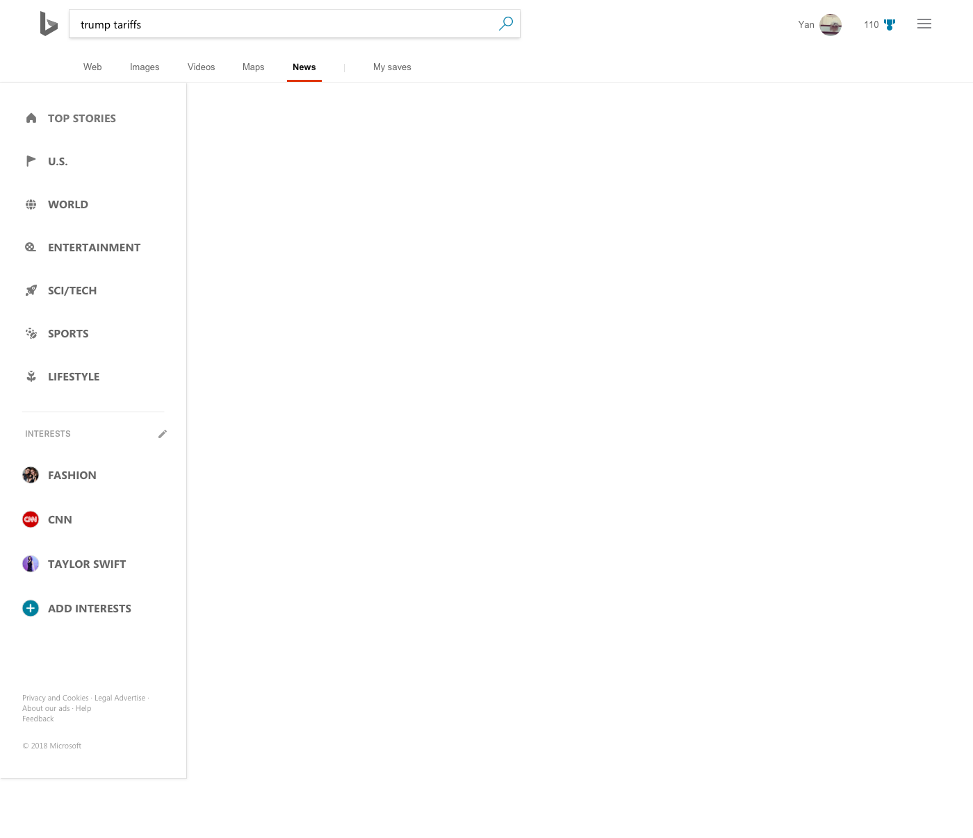
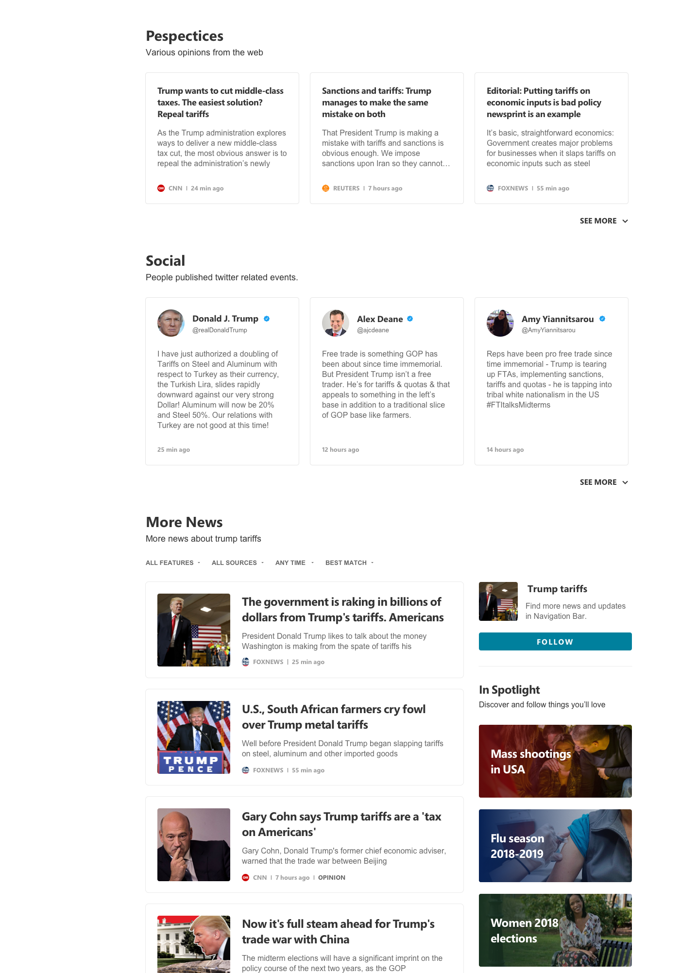
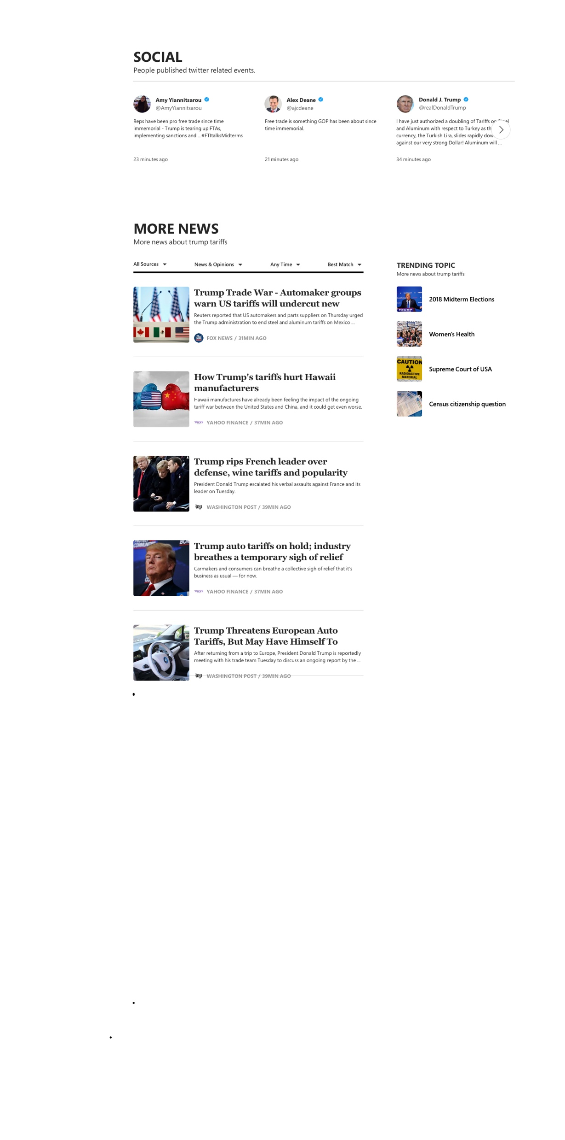
Concept 1
Concept 2
Inkjet
Letterpress
Efficient. Immersive. Visual.
Efficient. Simple. Elegant.

Slide 27


Grid system
Old
New

Slide 28


FRAMEWORK
SEARCH
BROWSE
Filter
Top News
Top Picks
Featured News
News
Categorized Content
Local / US / World / …
Rich Components
Perspectives / Rundown/
Social / Video / …
Right Rail
Entity / Follow / …
More News

Slide 29
Concept 1
Inkjet
Efficient. Immersive. Visual.

Slide 30
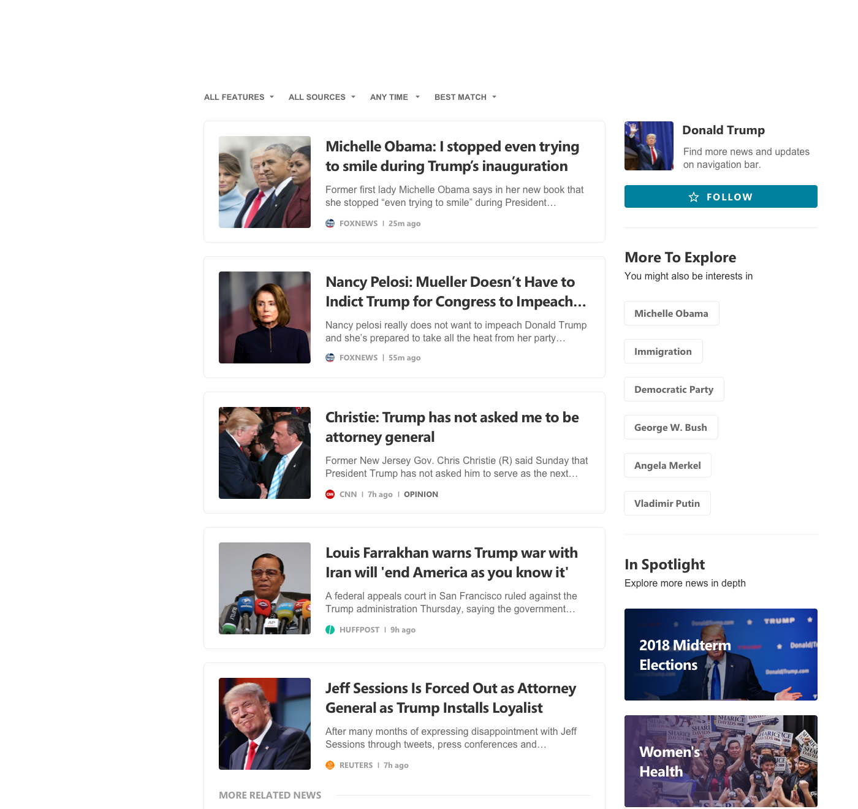
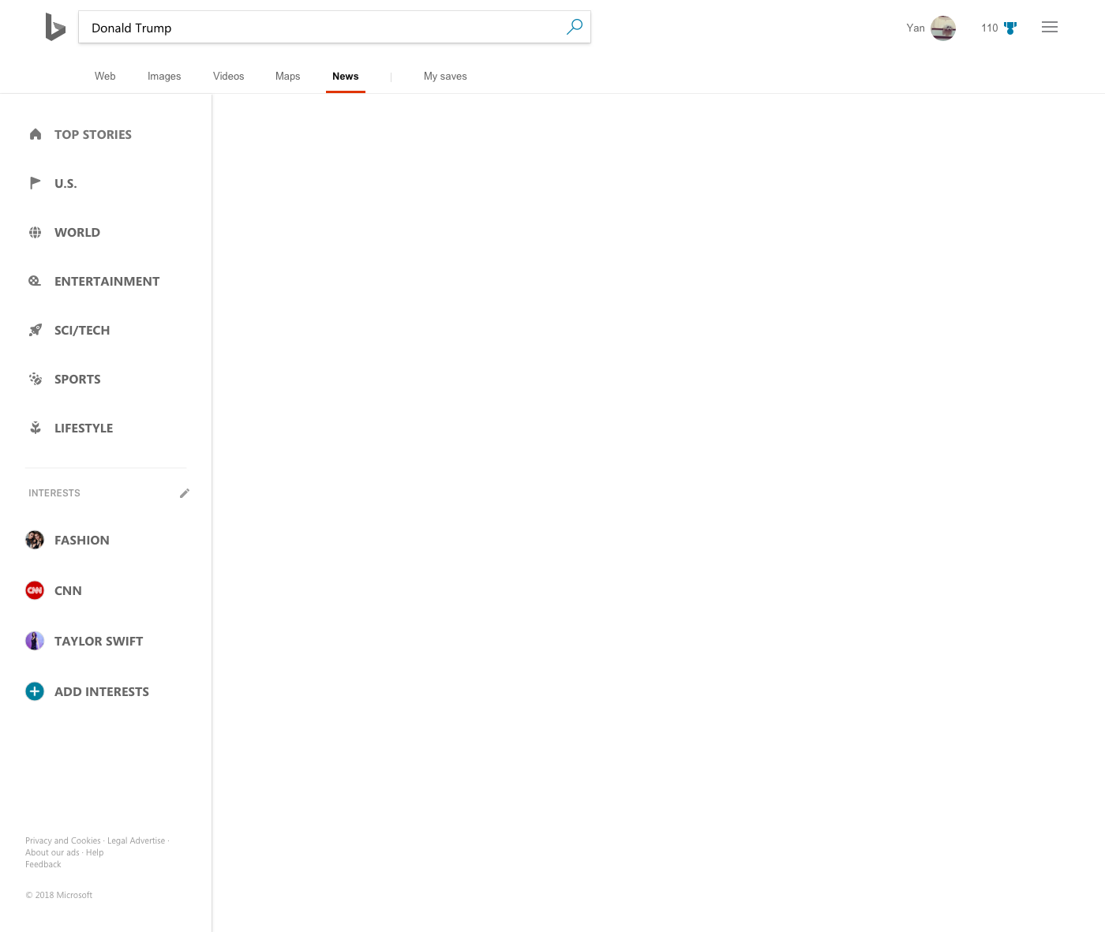
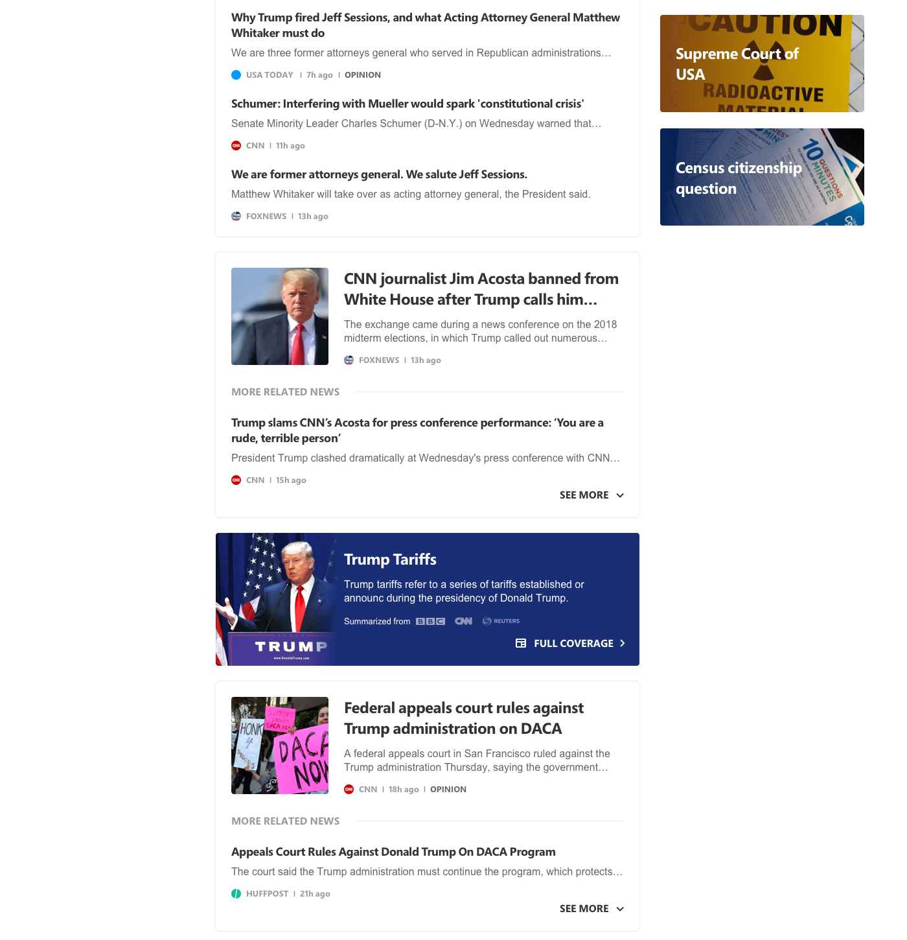
SEARCH EXPERIENCE
NEWS SEEKERS
VISUAL
Big, bold font, better alignment and layout for easy reading, bring more focus to content.

Slide 31
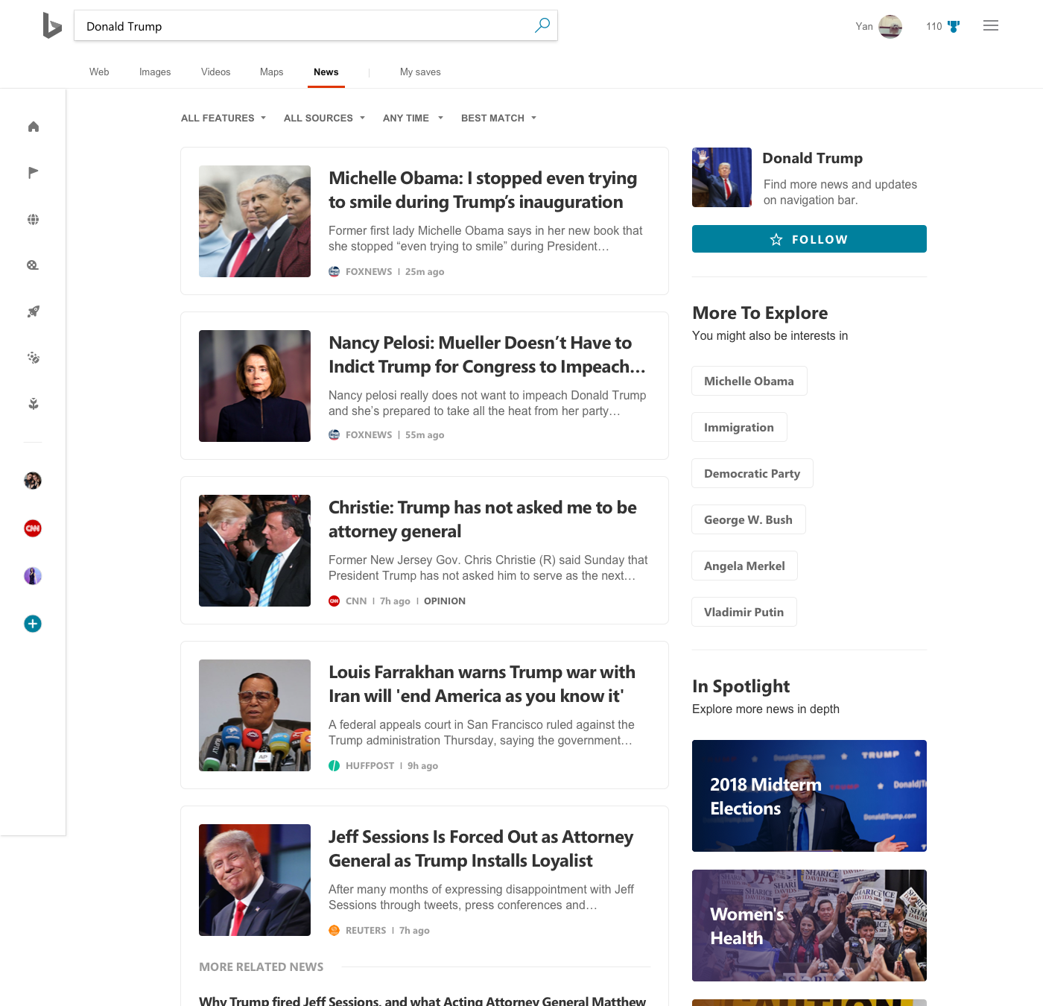
SEARCH EXPERIENCE
NEWS SEEKERS
NAVIGATION
Fast & customizable navigation

Slide 32
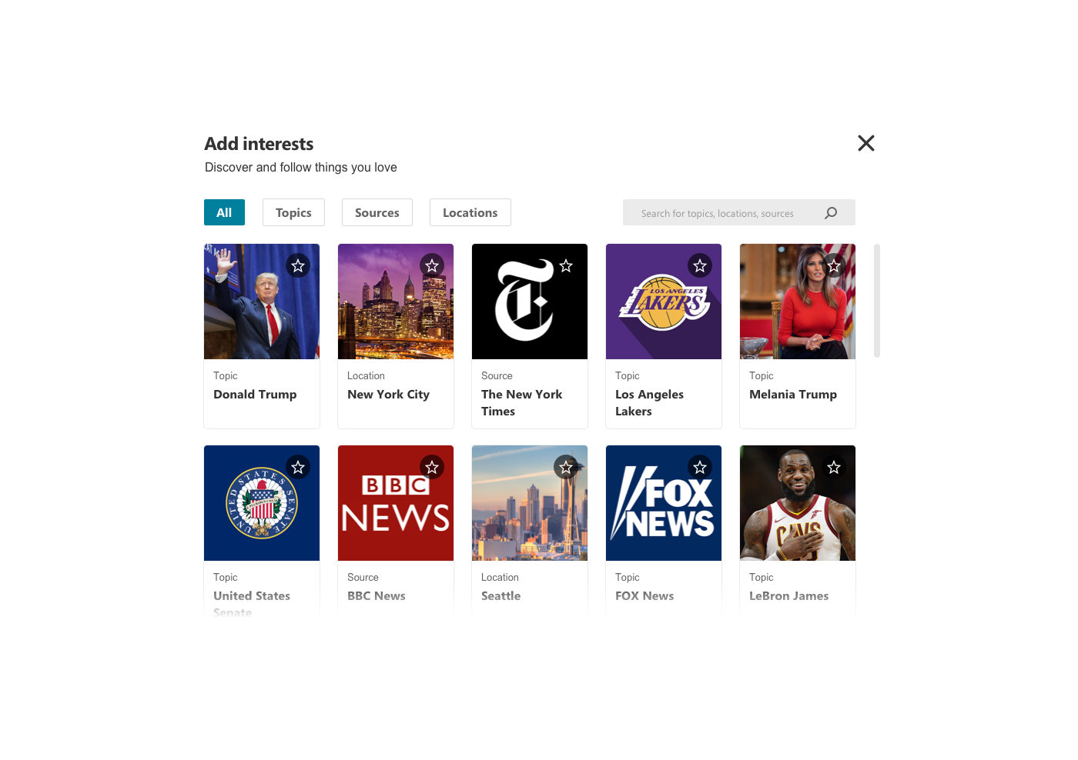
SEARCH EXPERIENCE
NEWS SEEKERS
INTERESTS
Discover and follow interests more easily
NAVIGATION
Fast & customizable navigation
INTERESTS
Easy control to add interest in the nav bar

Slide 33
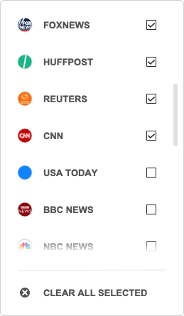
SEARCH EXPERIENCE
NEWS SEEKERS
FILTER
More control on
what to read

Slide 34
SEARCH EXPERIENCE
CLUSTER
More efficient way
to get informed

Slide 35
SEARCH EXPERIENCE
NEWS SEEKERS
ENTRY POINT TO
COMPREHENSIVE VIEW
Easily to go-deep into
a story

Slide 36
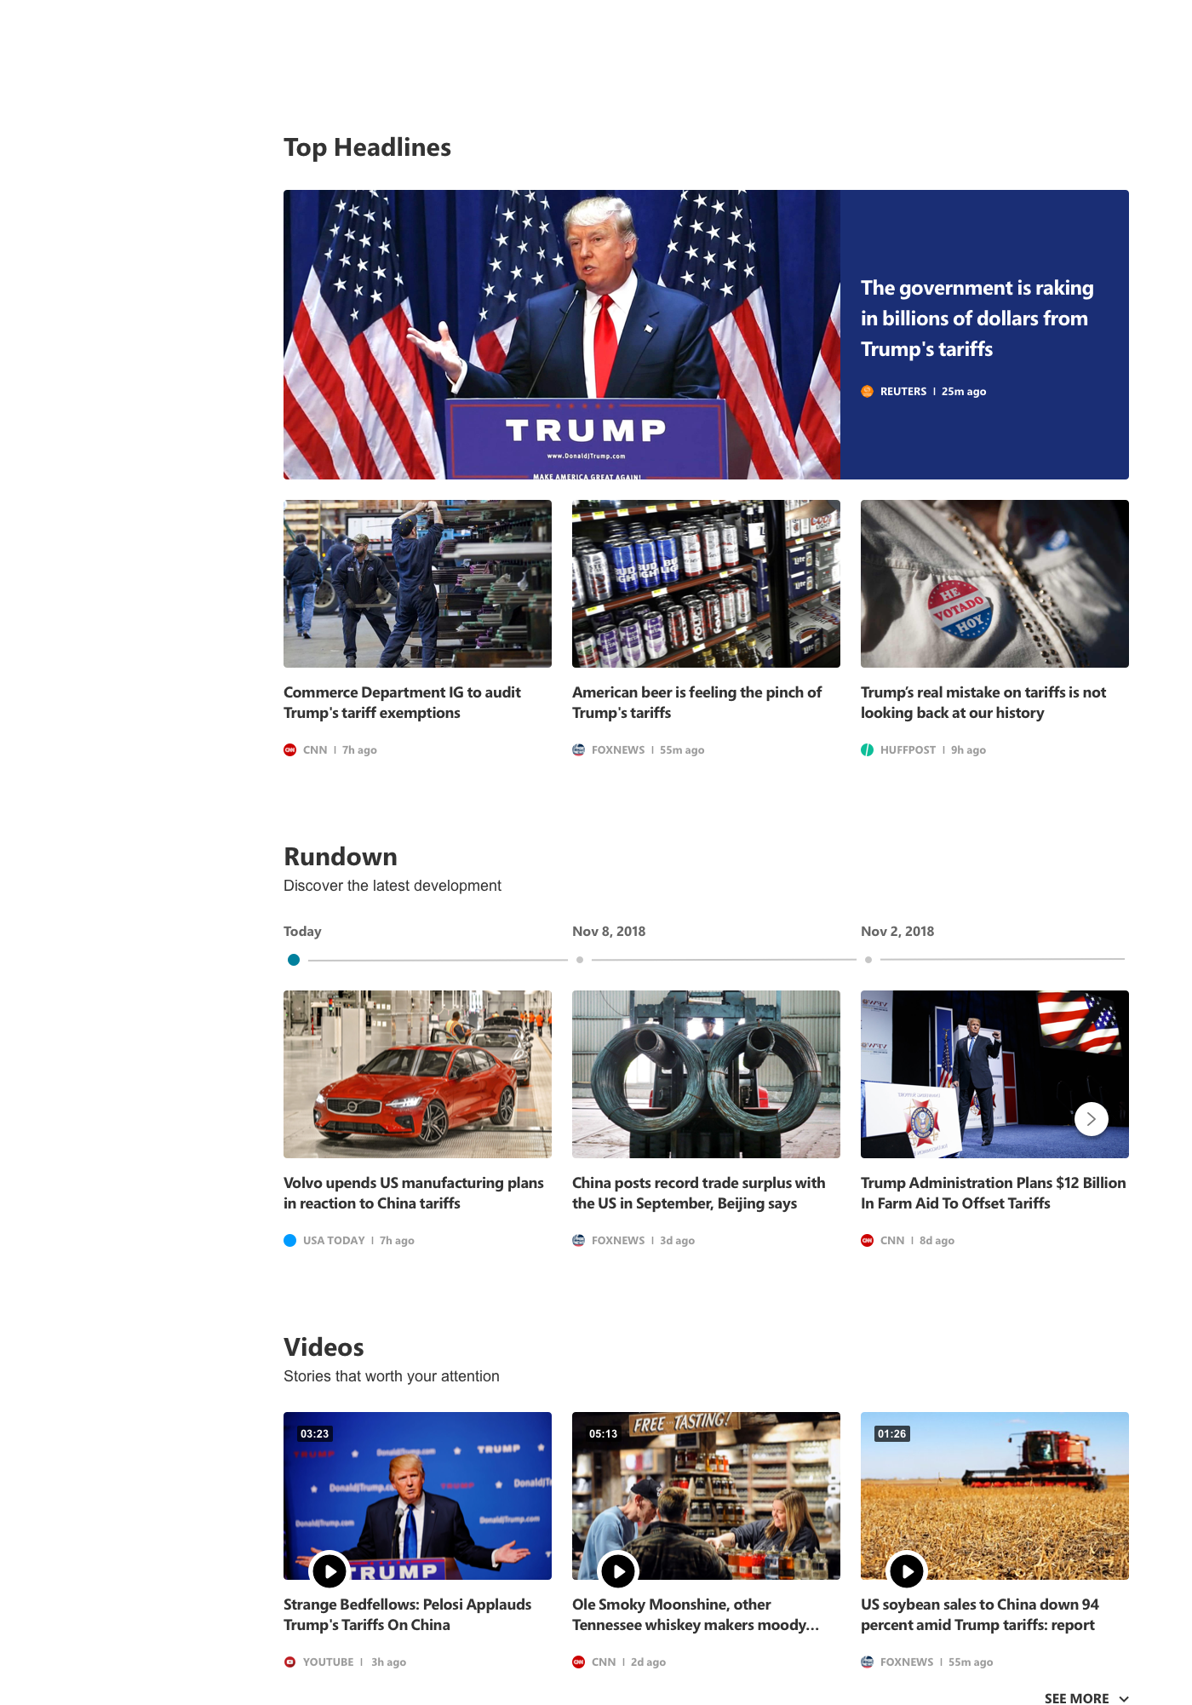
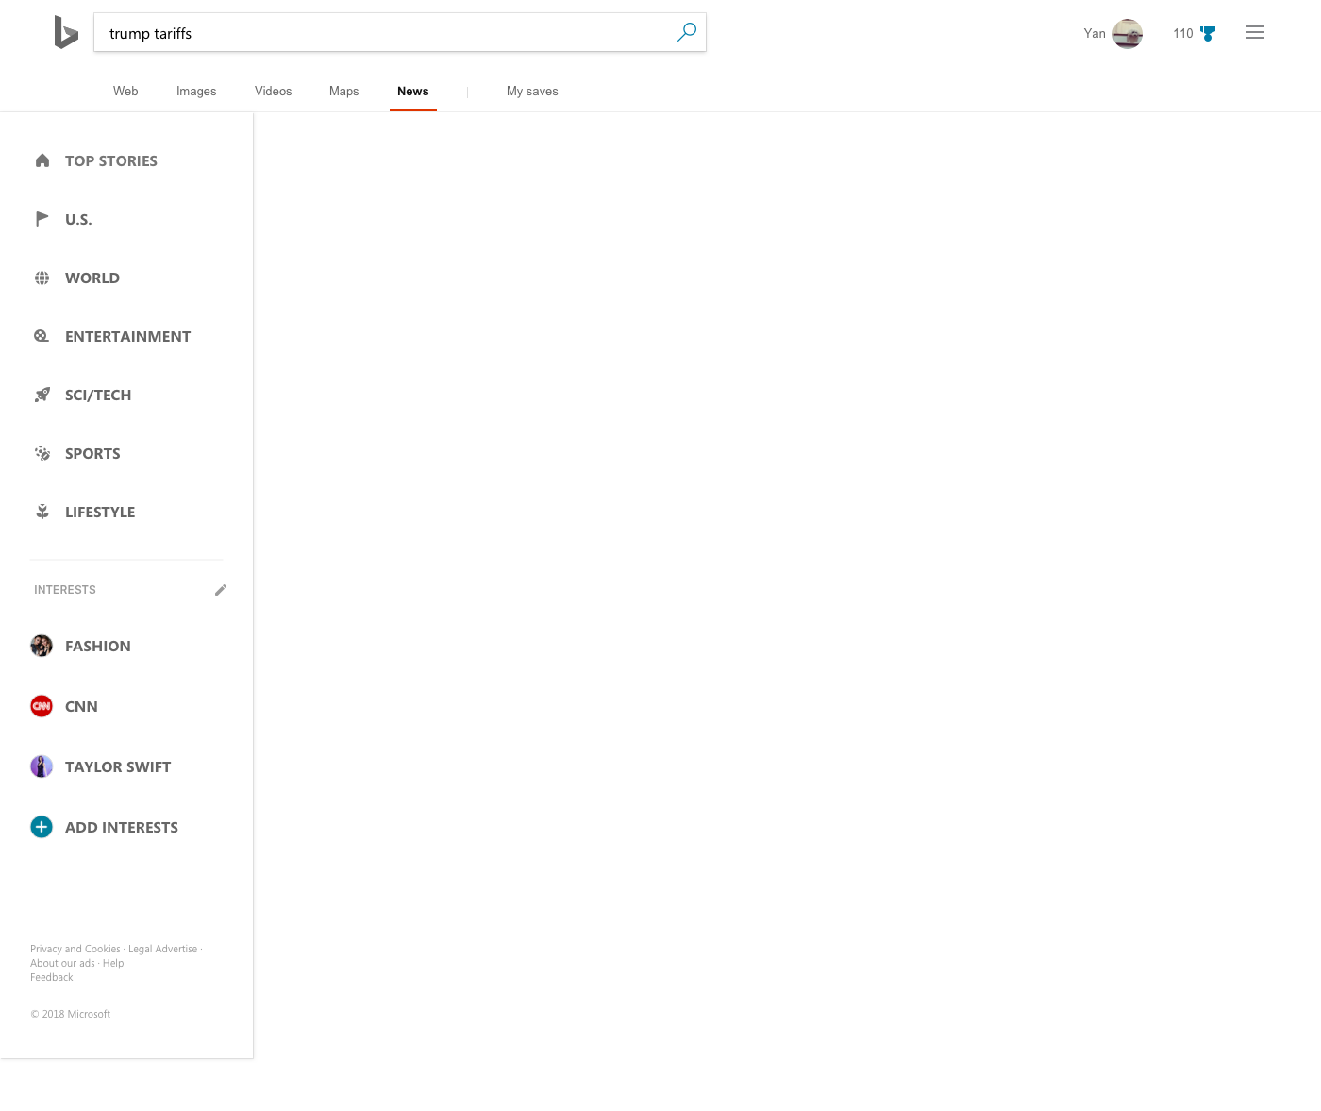
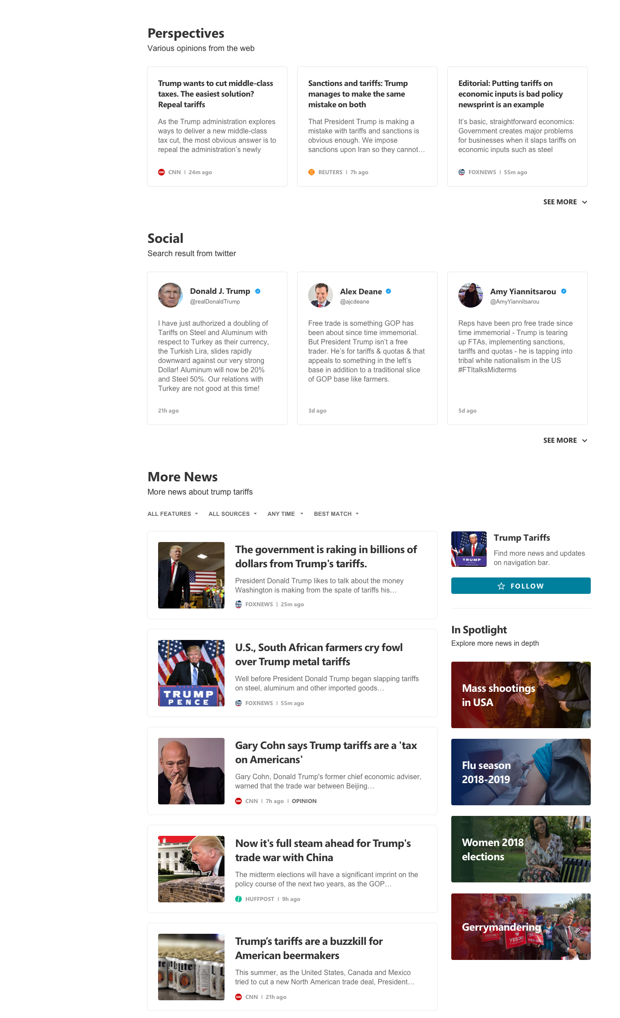
BROWSE EXPERIENCE
NEWS SEEKERS
TOP HEADLINES
Prominent top stories to
Give readers a quick
overview of the event

Slide 37
BROWSE EXPERIENCE
NEWS SEEKERS
RUNDOWN
Fast to get the latest
development
Notes:
Information overload: some people were confused about how the articles/stories were displayed, felt very random and disorganized . Hard to scan through the news.” I don’t know what to do or where to look at first, I feel im definitely going to miss some important news.”

Slide 38
BROWSE EXPERIENCE
NEWS SEEKERS
VIDEO NEWS
Explore more news that
moves
PERSPECTIVES
Easily get all-side’s
opinions on a topic
Notes:
Information overload: some people were confused about how the articles/stories were displayed, felt very random and disorganized . Hard to scan through the news.” I don’t know what to do or where to look at first, I feel im definitely going to miss some important news.”

Slide 39
BROWSE EXPERIENCE
NEWS SEEKERS
SOCIAL
See what’s happening on twitter

Slide 40
BROWSE EXPERIENCE
NEWS SEEKERS
MORE NEWS
More content to explore

Slide 41
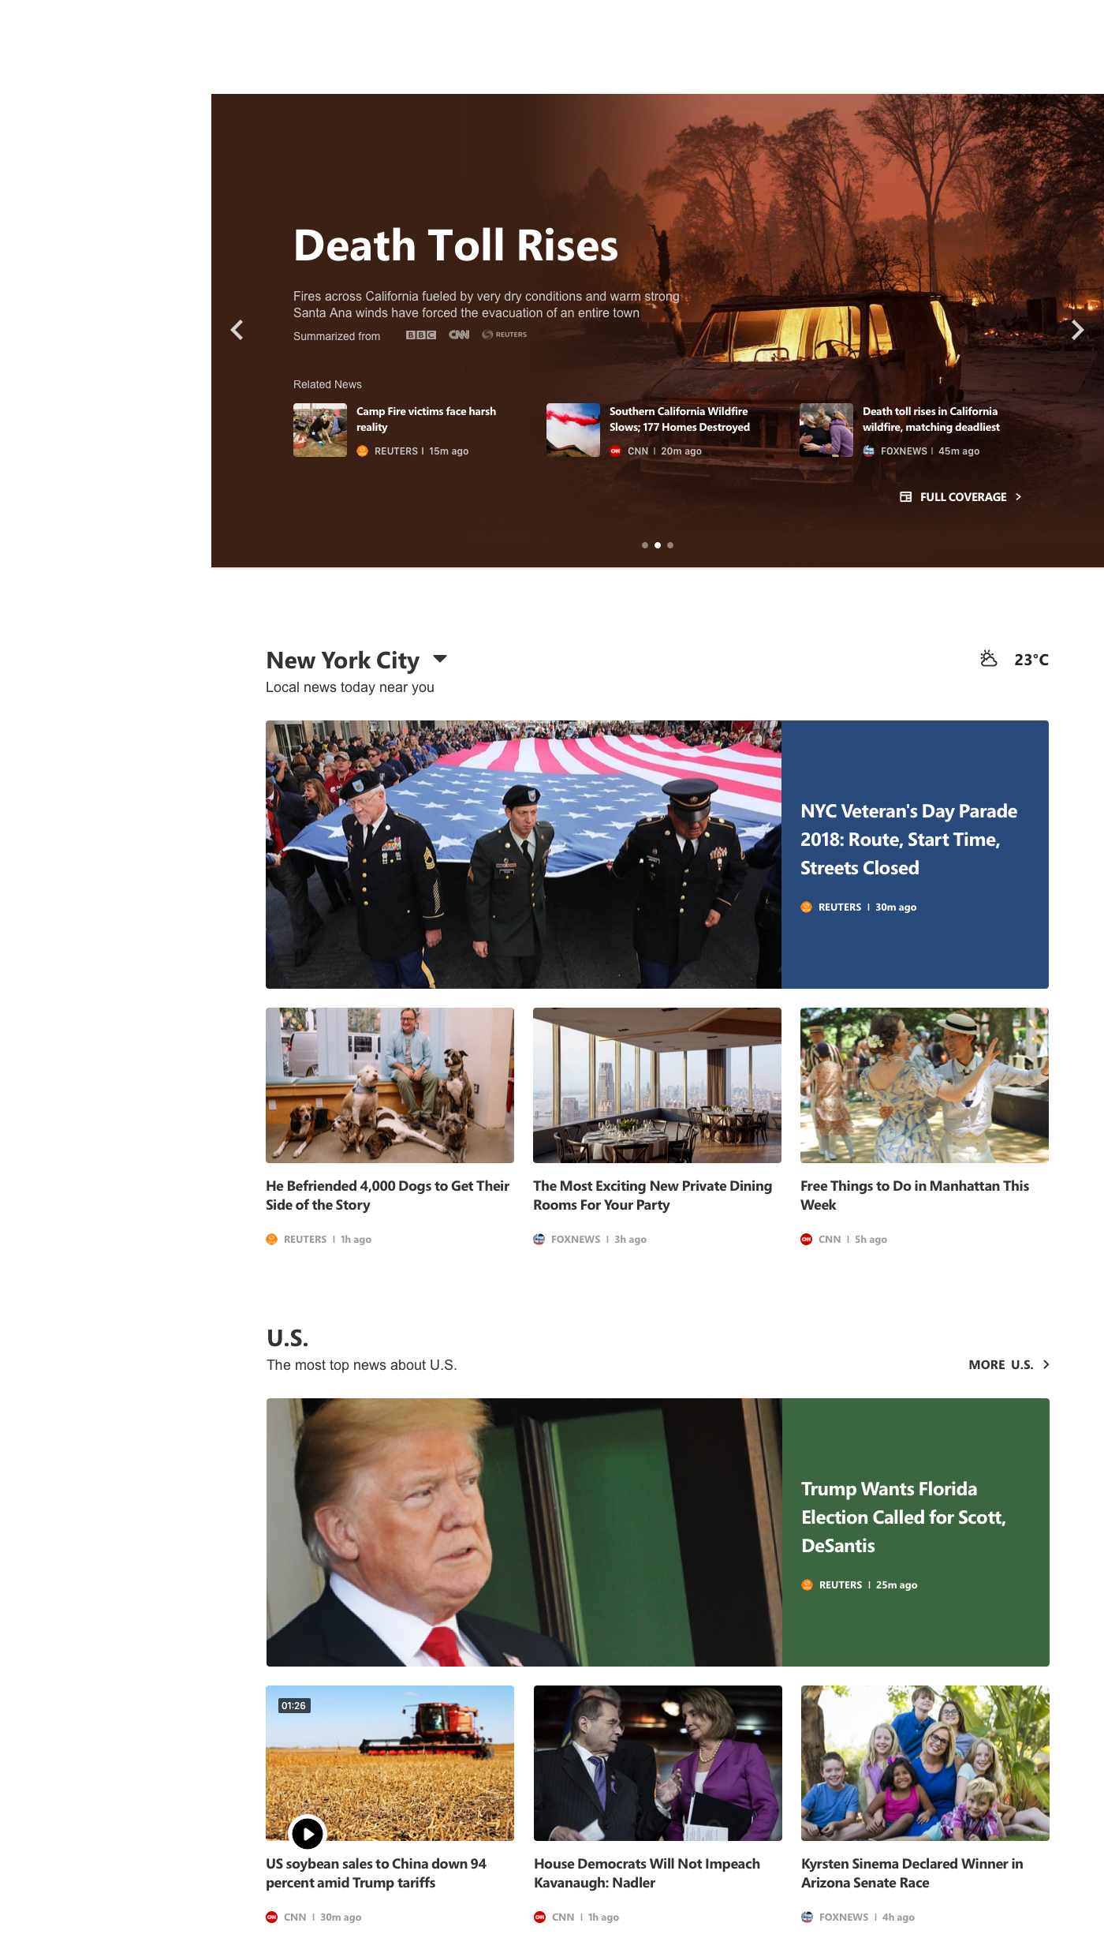
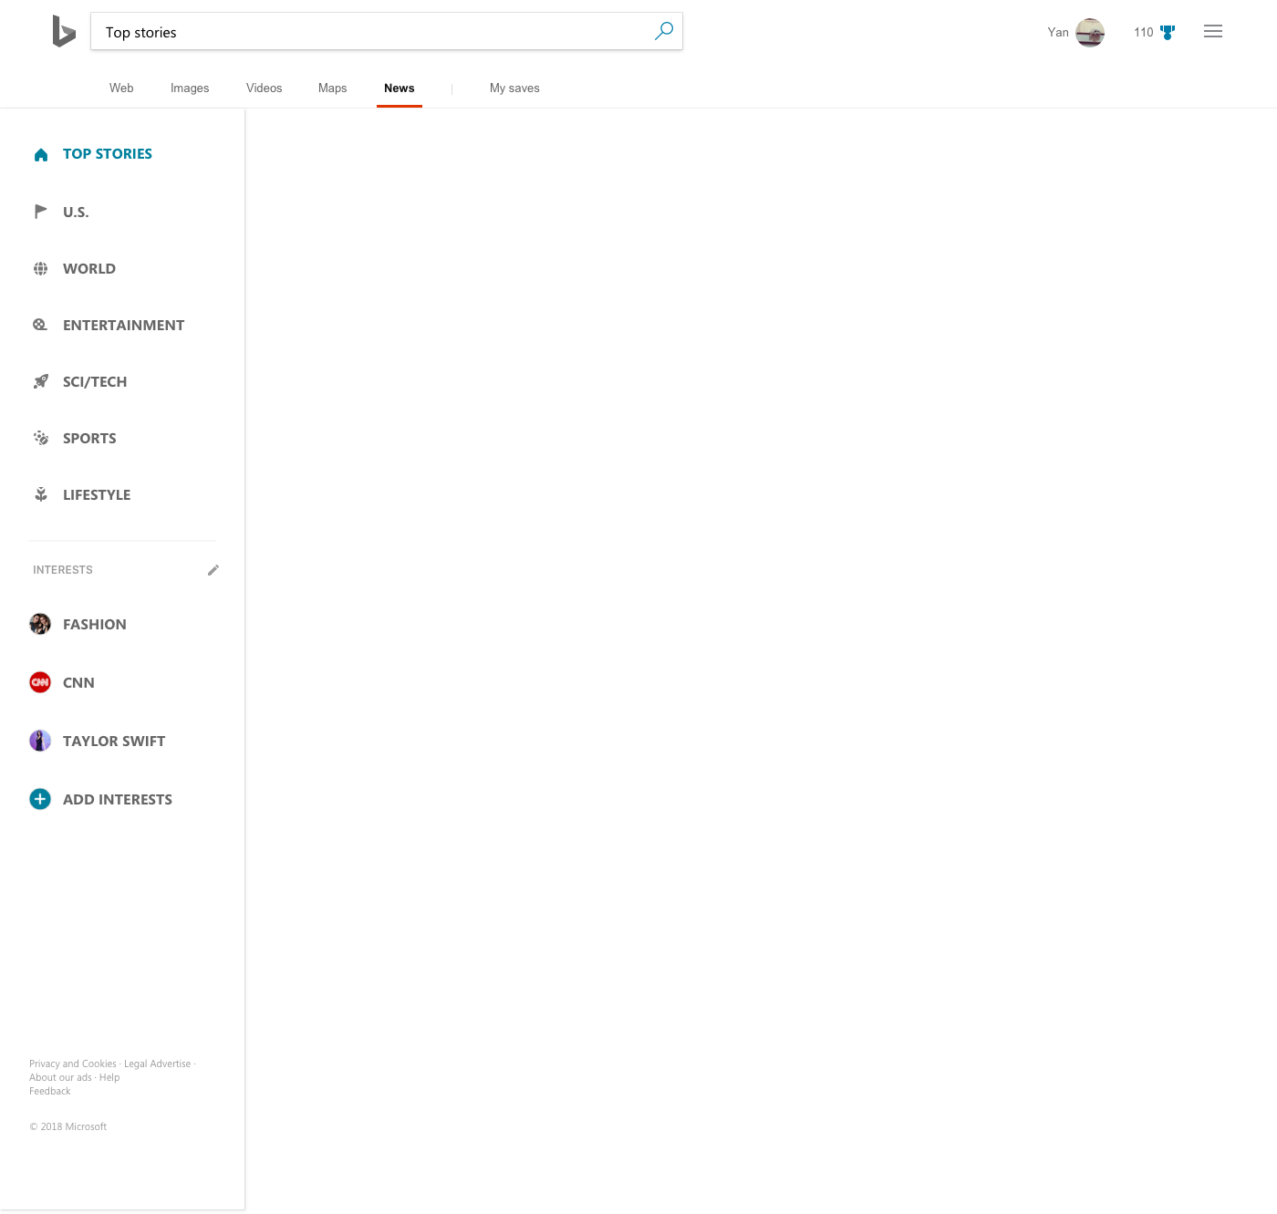
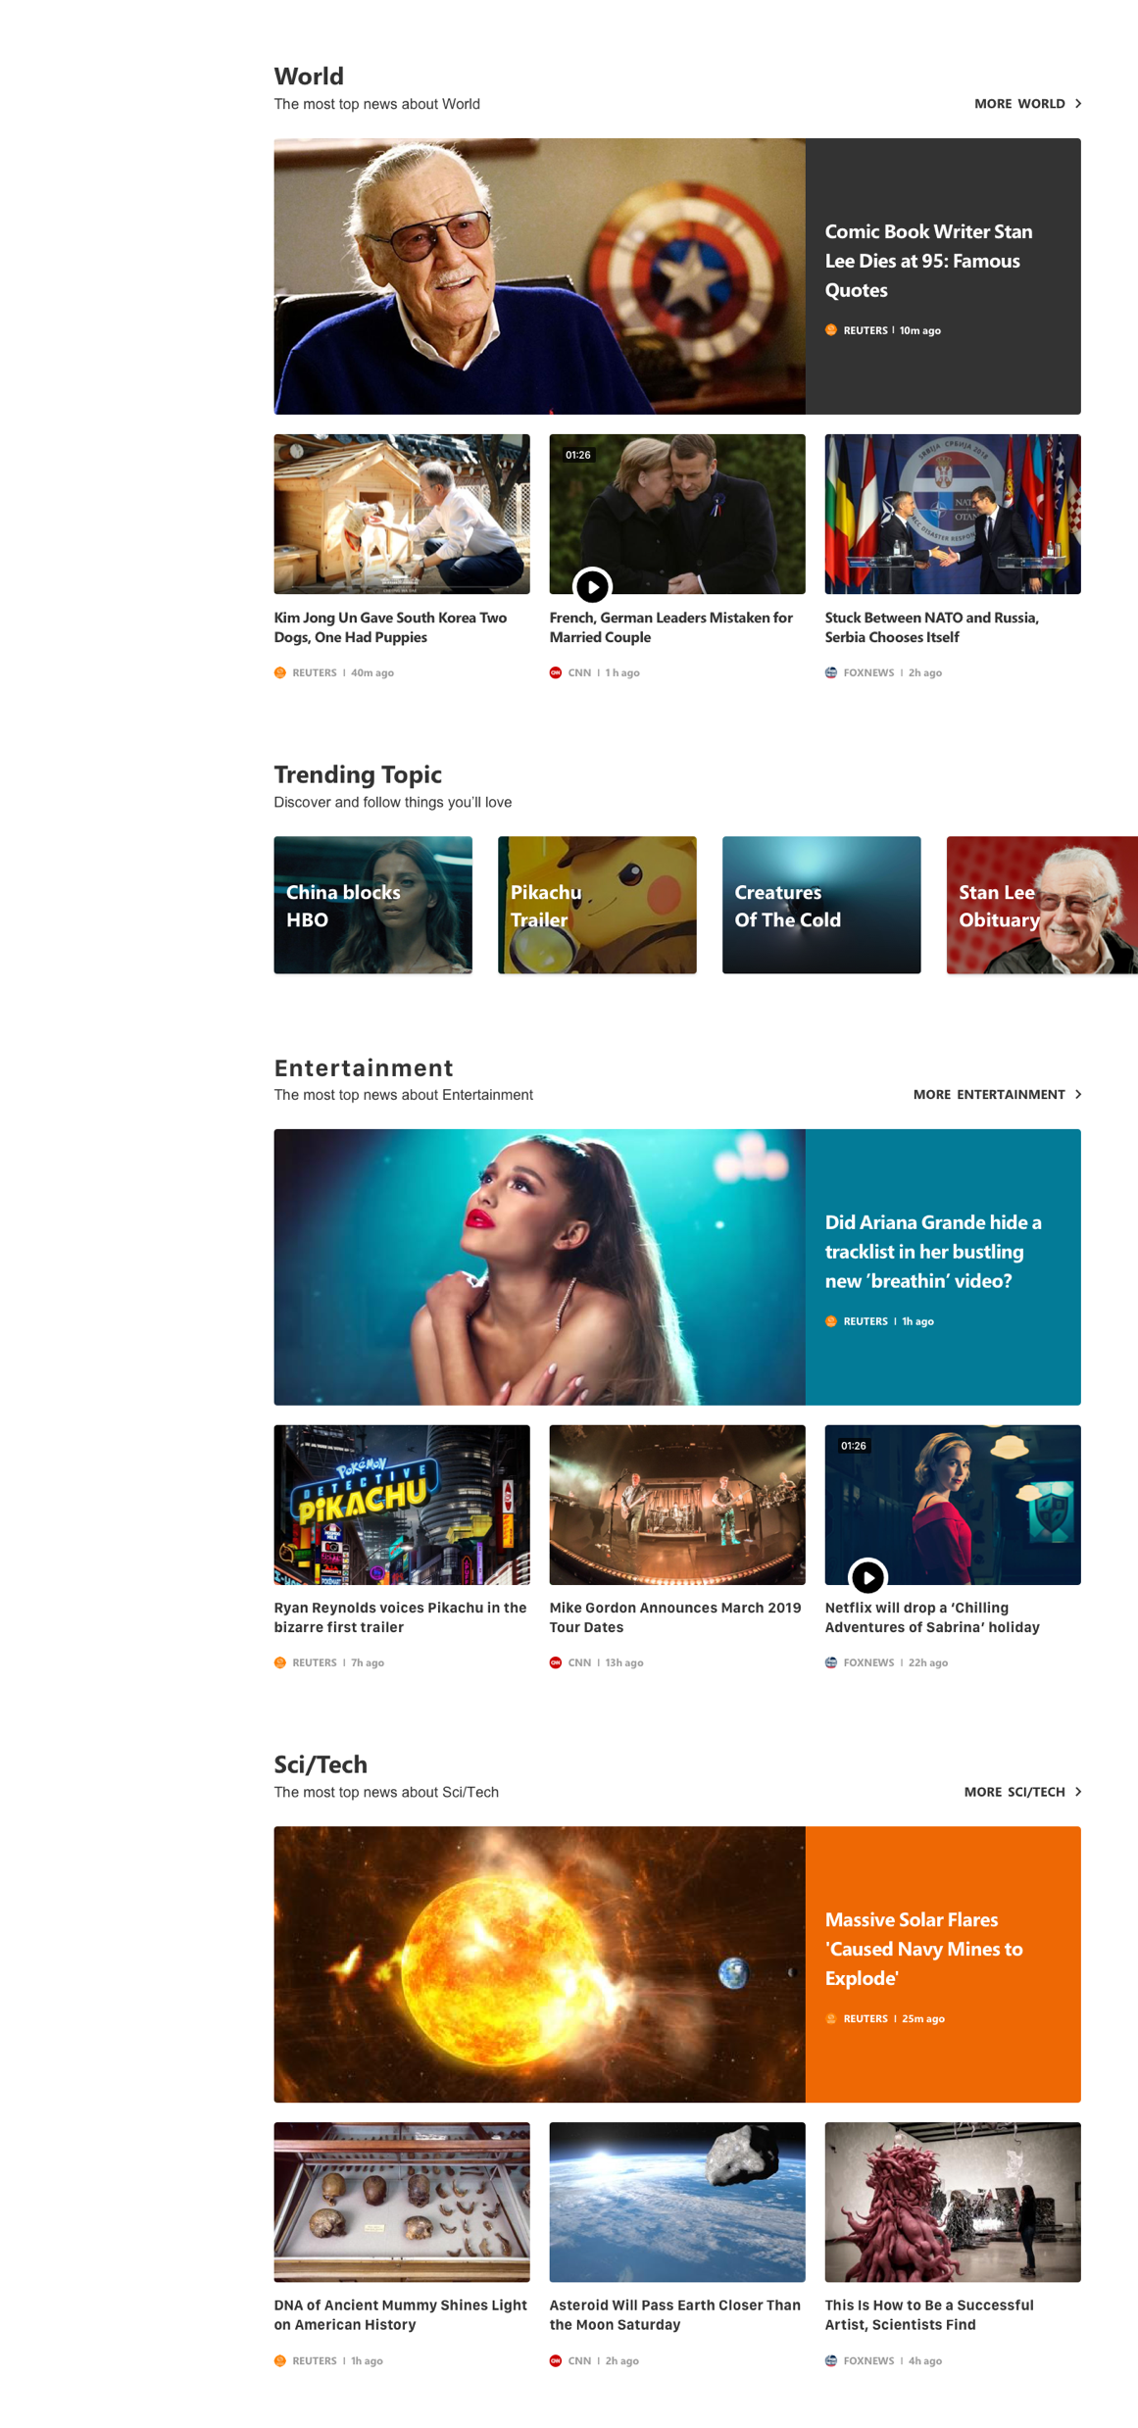
TOP STORIES
TOP HEADLINES
Discover today’s headline news with related coverage

Slide 42
TOP STORIES
ORGANIZATION
Content organized by sections to give readers a quick overview on today’s top stories

Slide 43
TOP STORIES
TRENDING TOPIC
Explore more trending topics or events

Slide 44
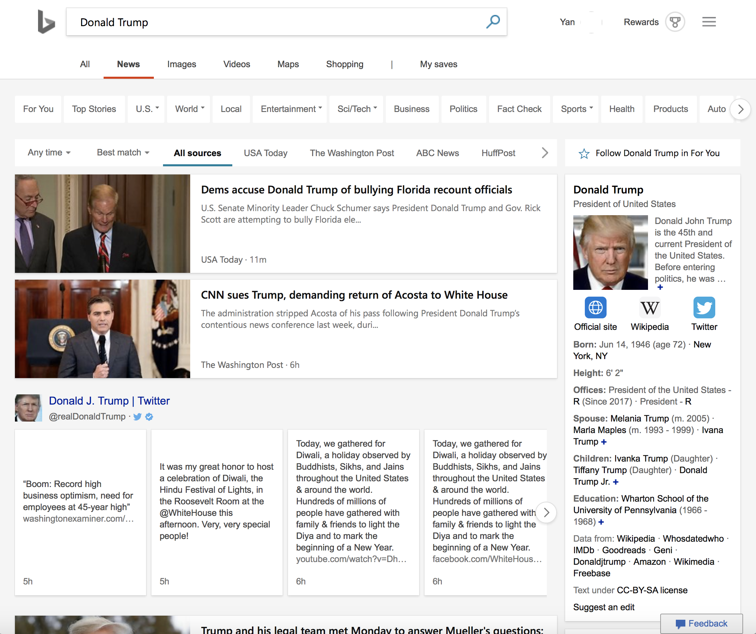
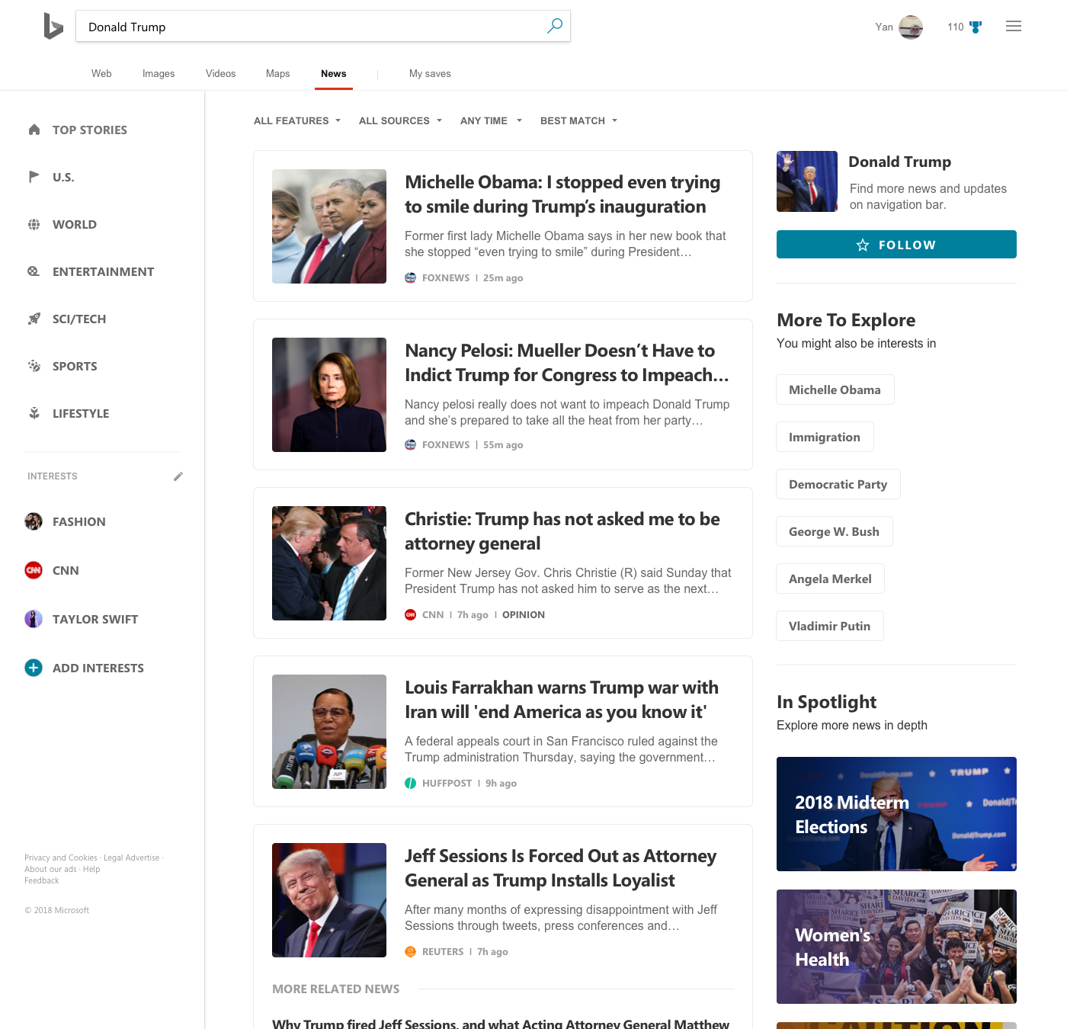
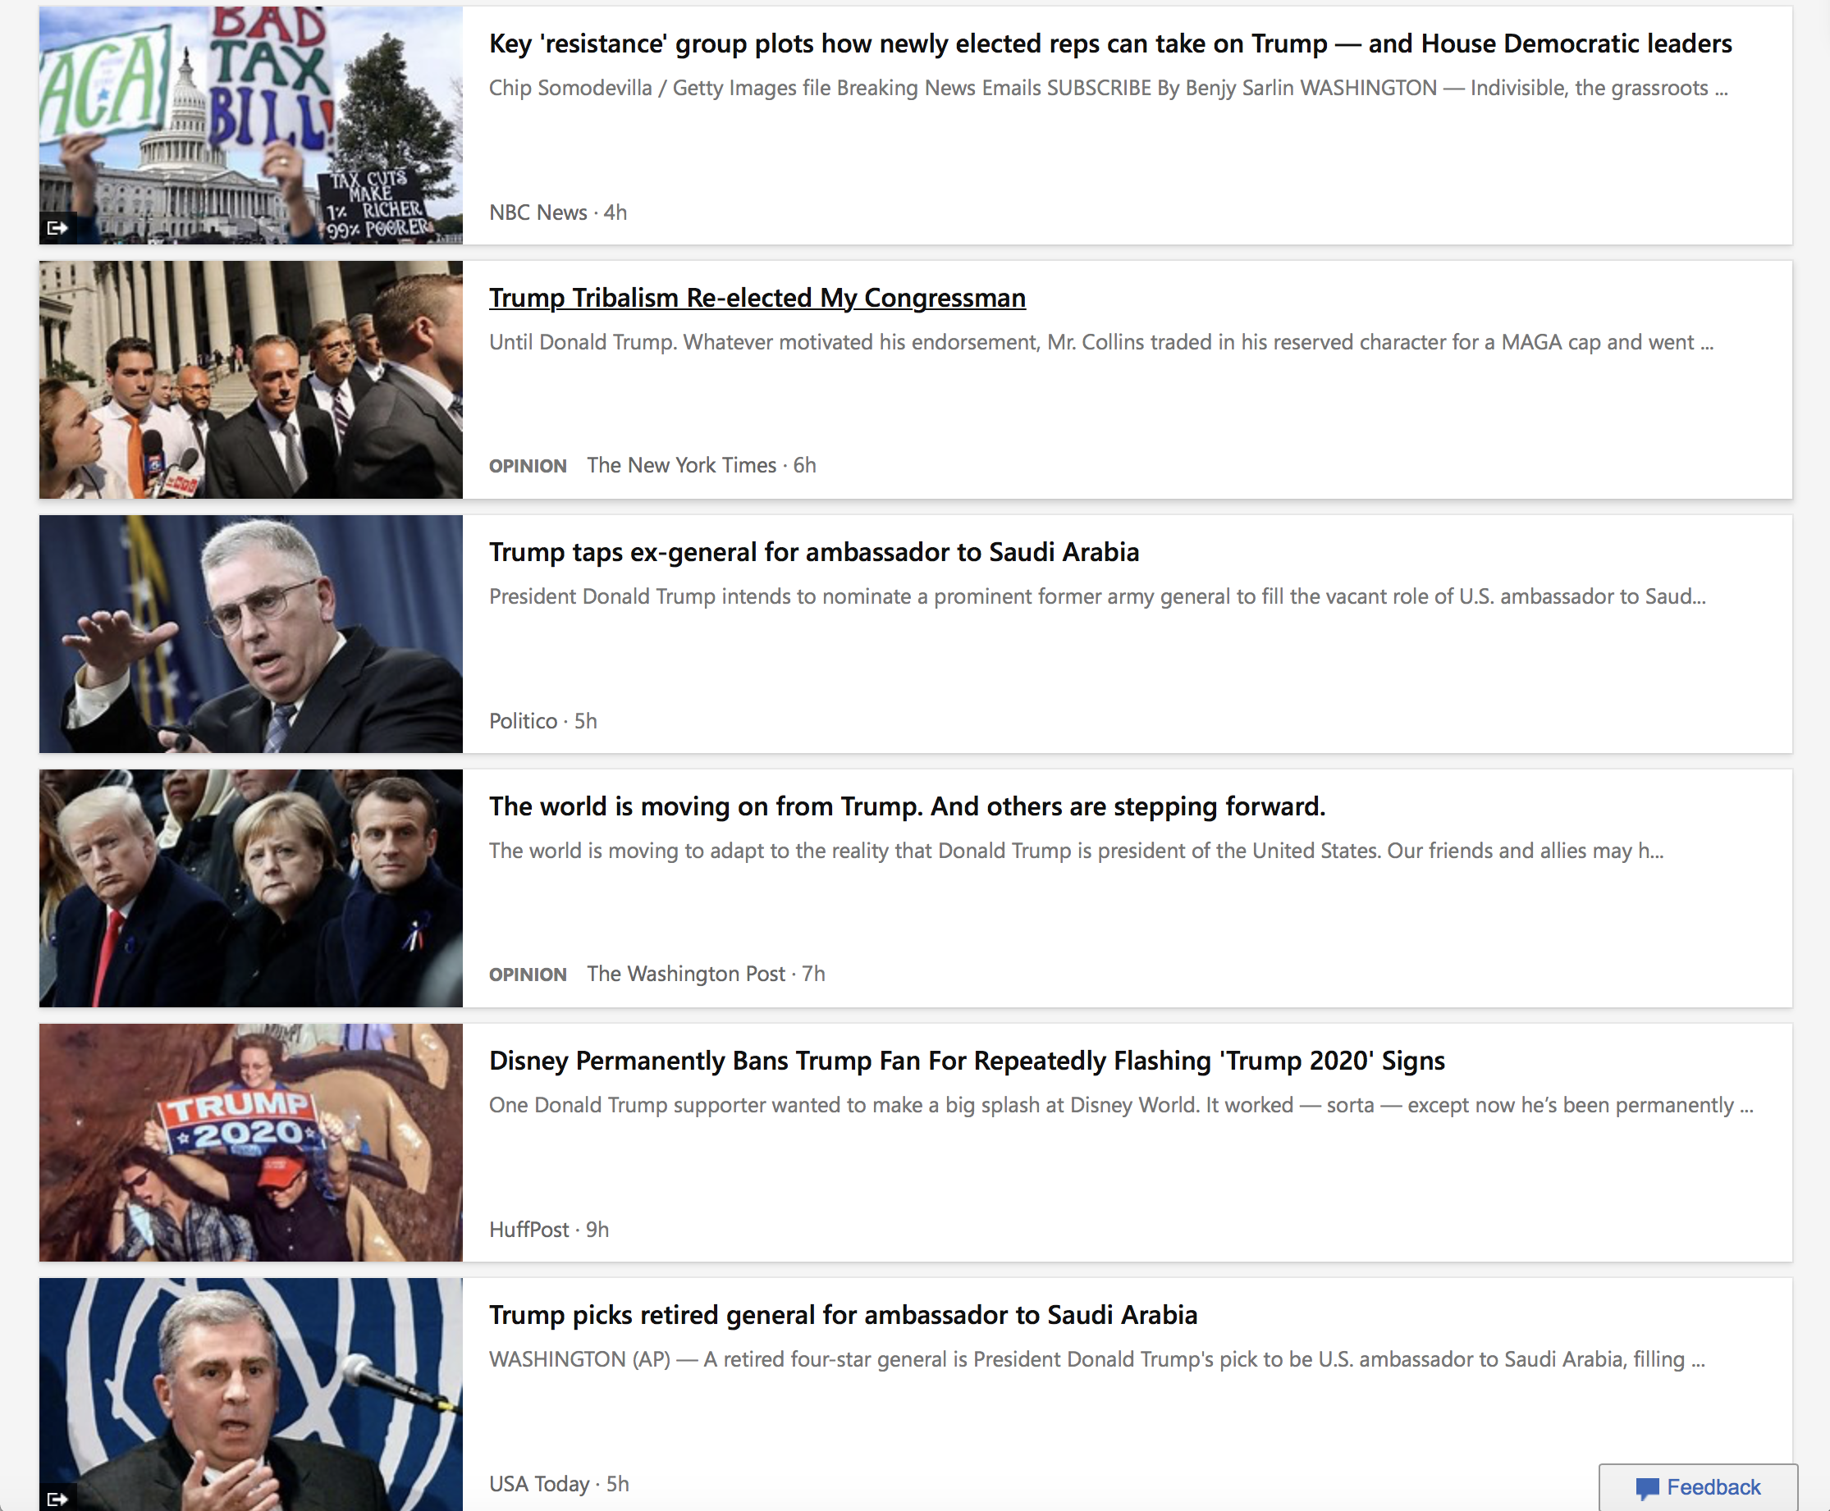
OLD SEARCH
NEW SEARCH

Slide 45
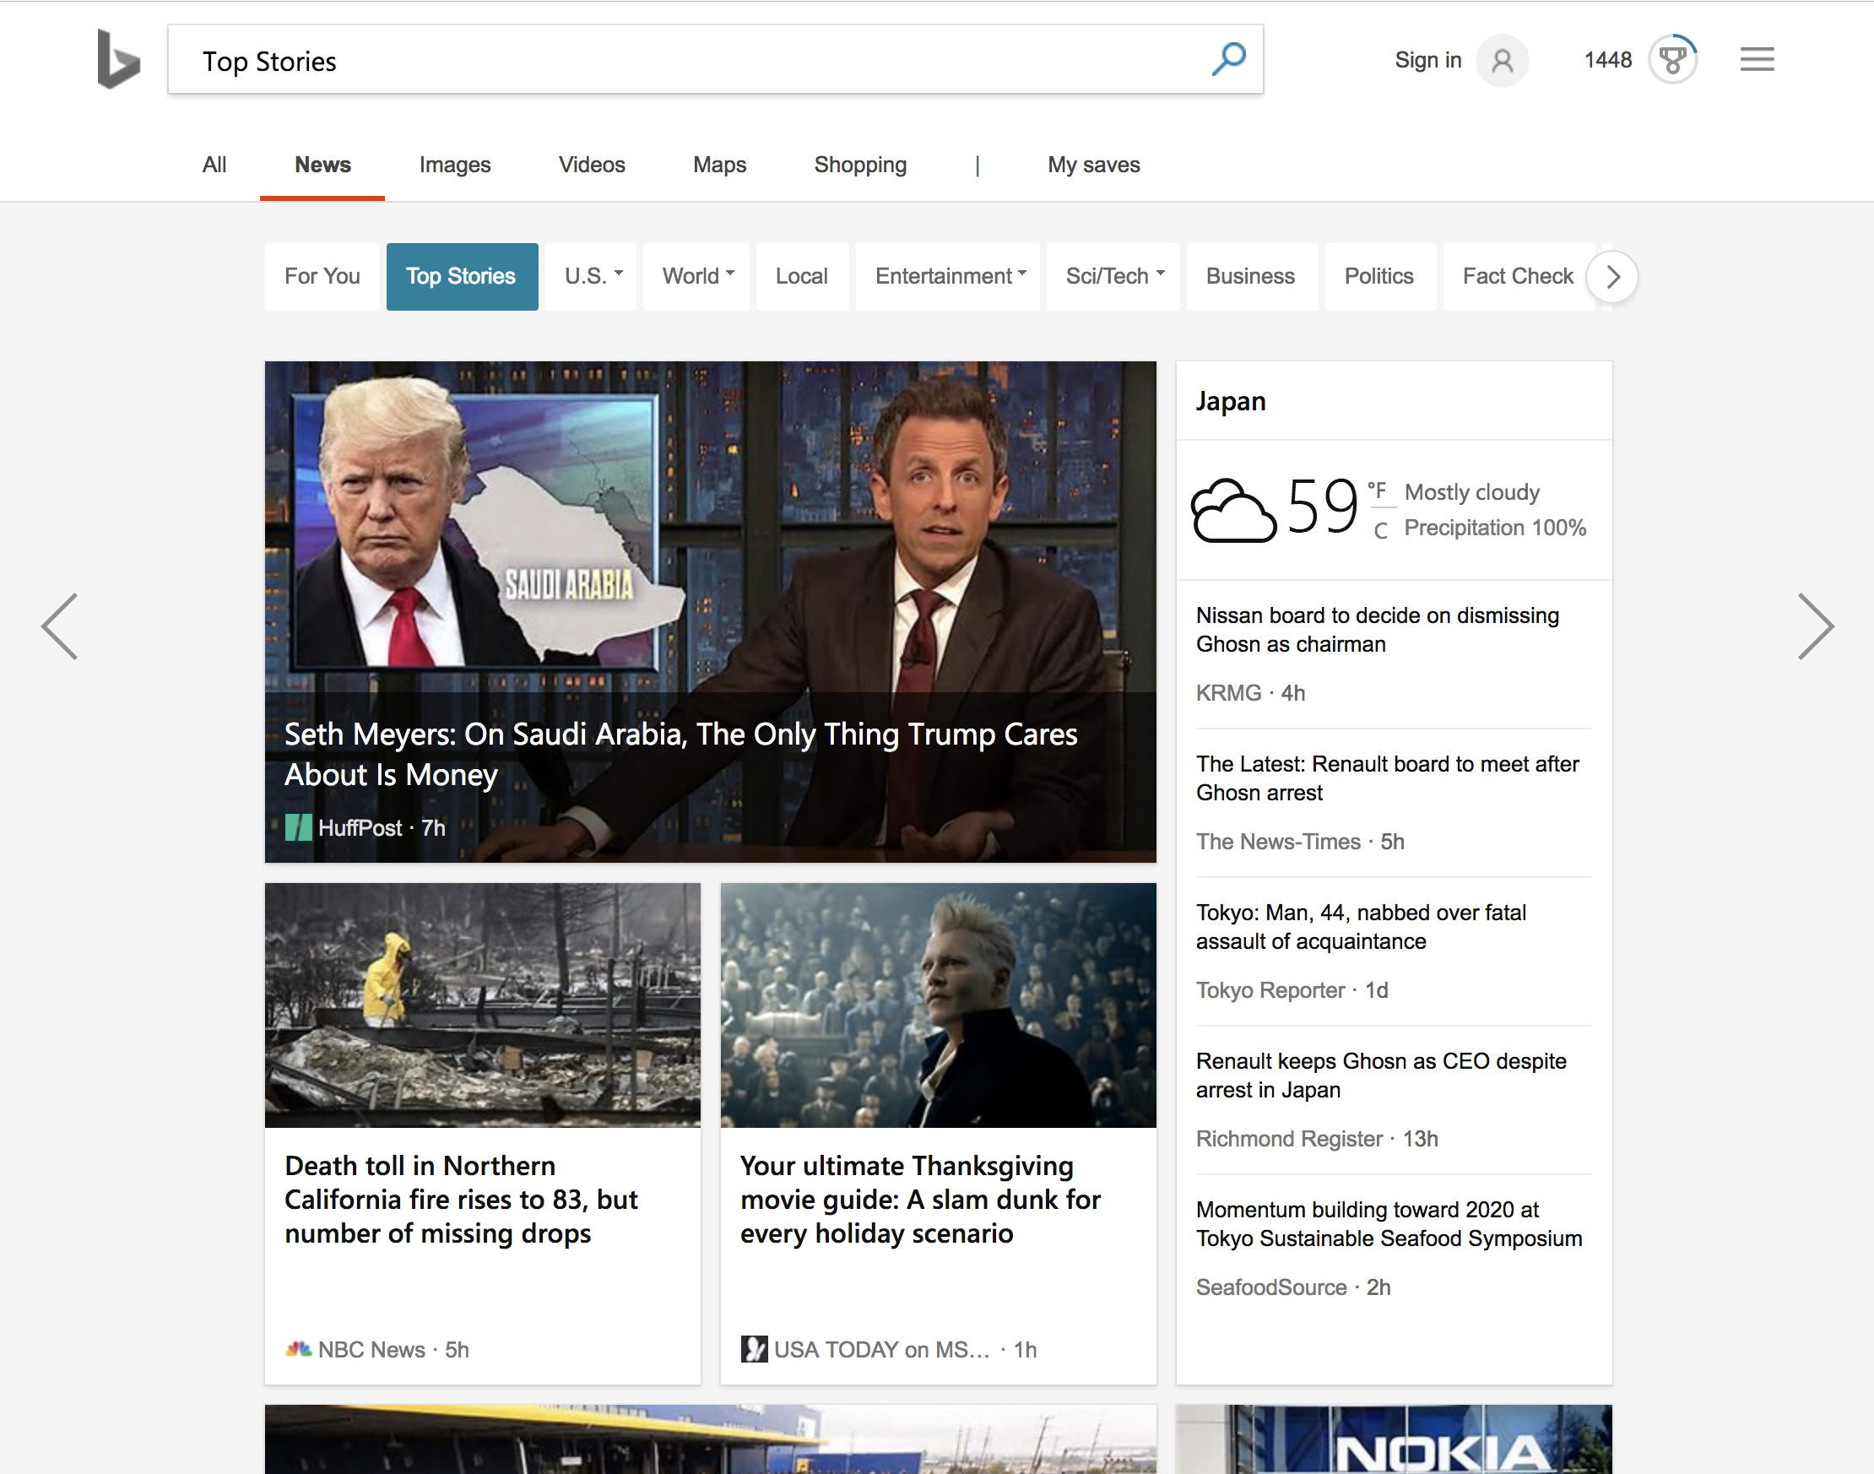
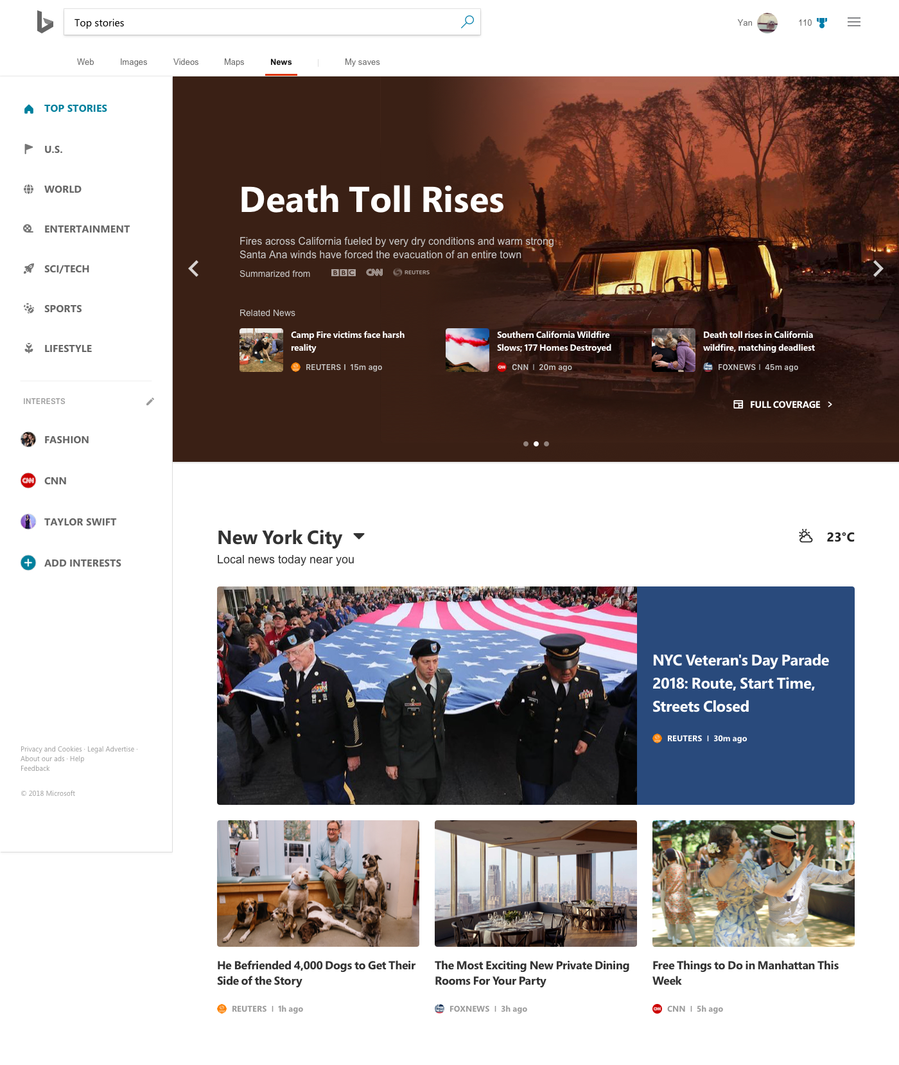
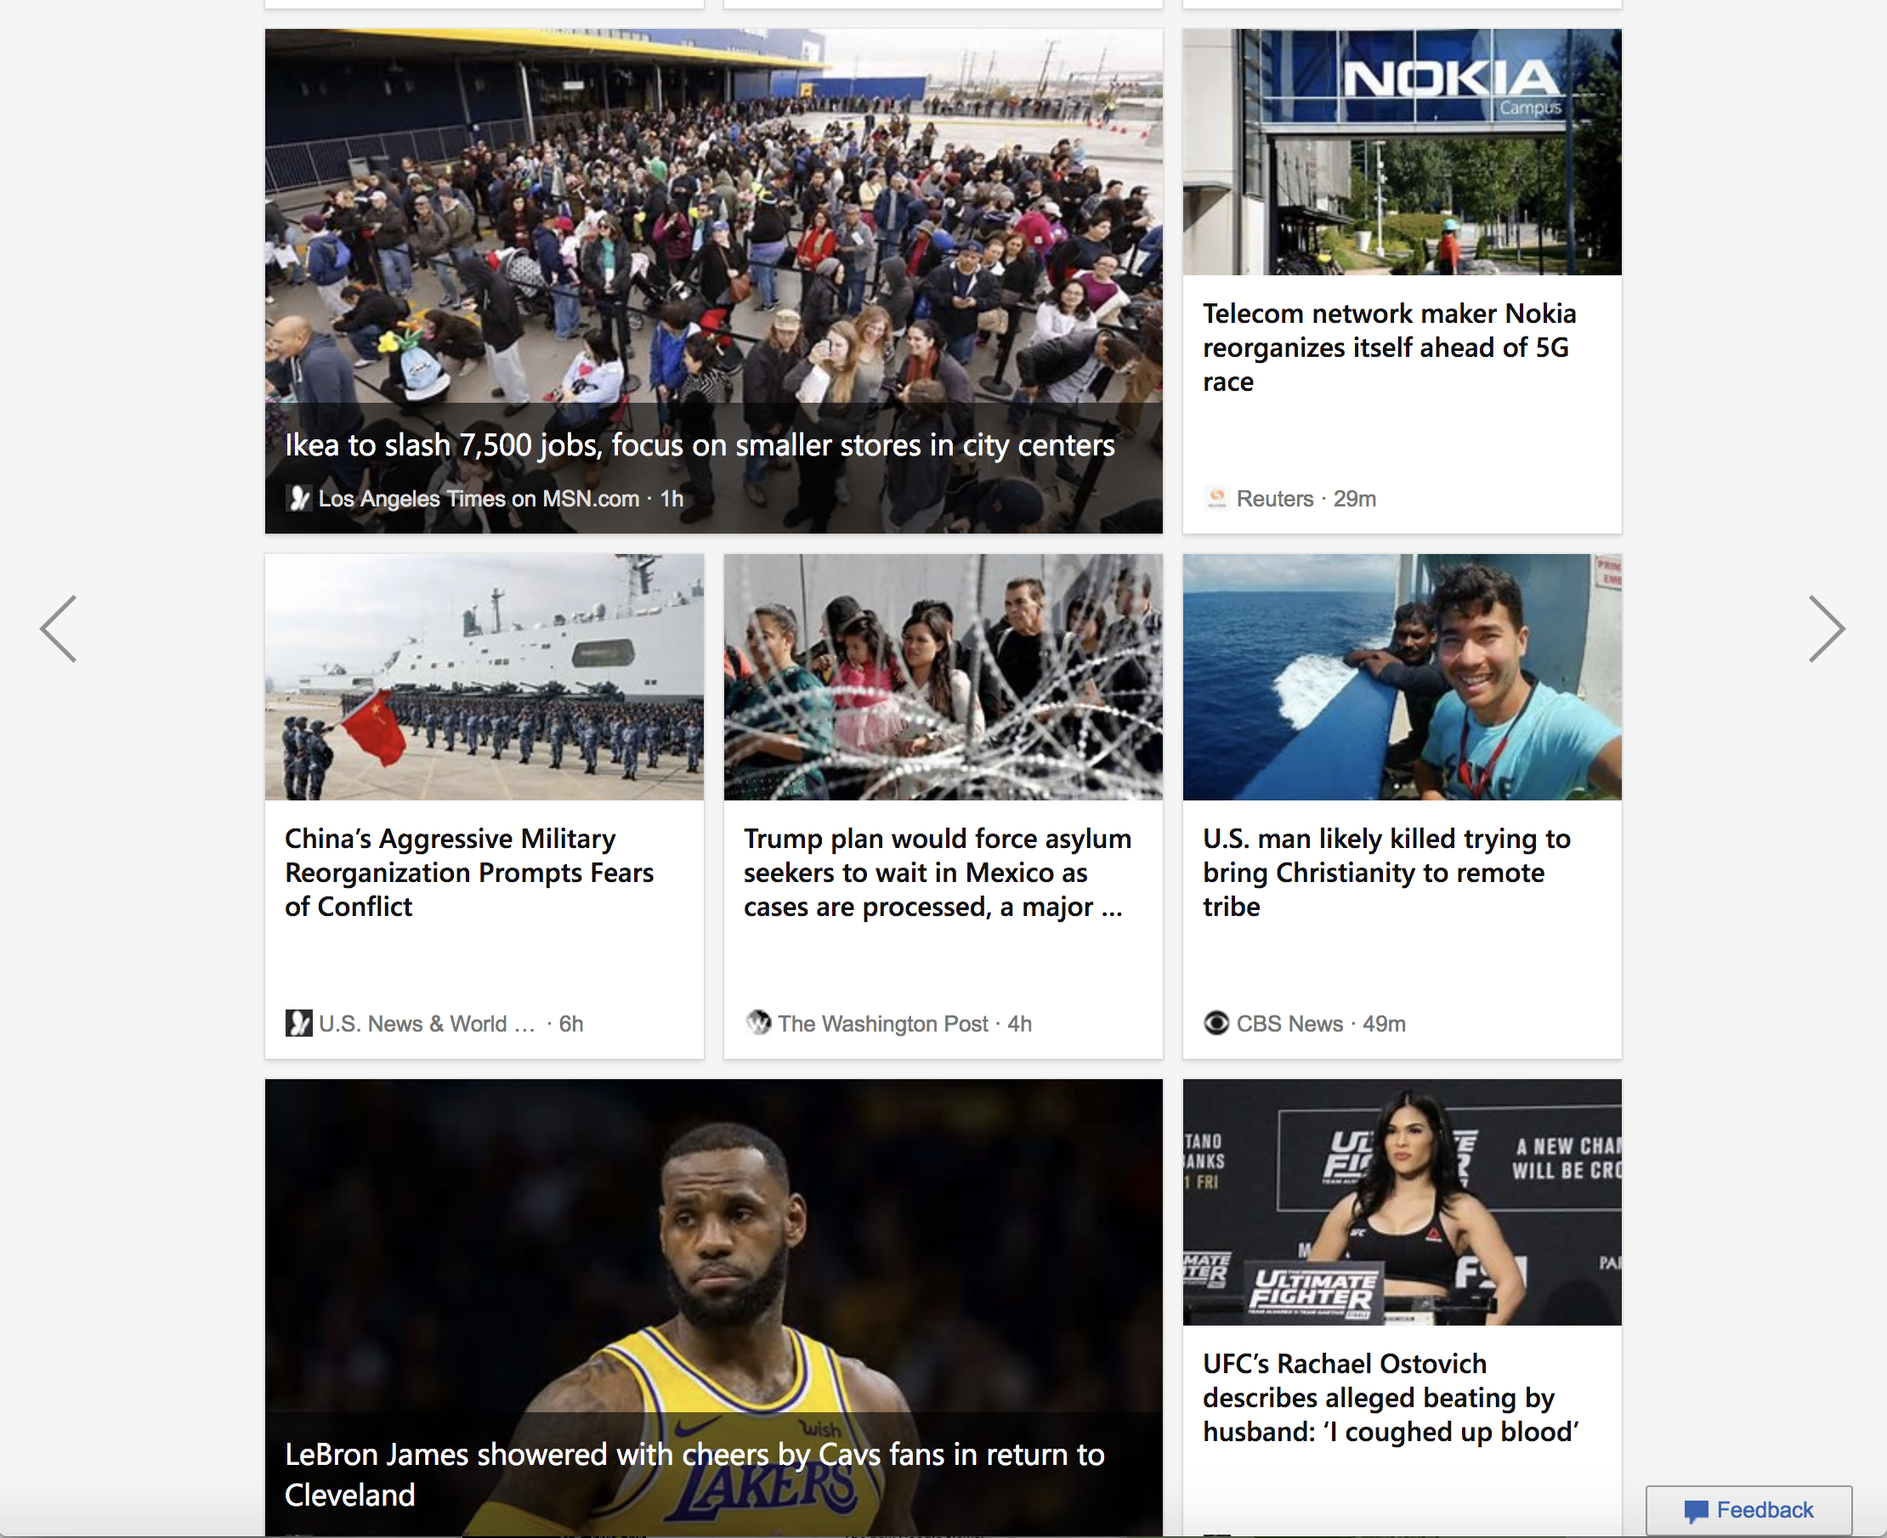
OLD BROWSE
NEW BROWSE

Slide 46
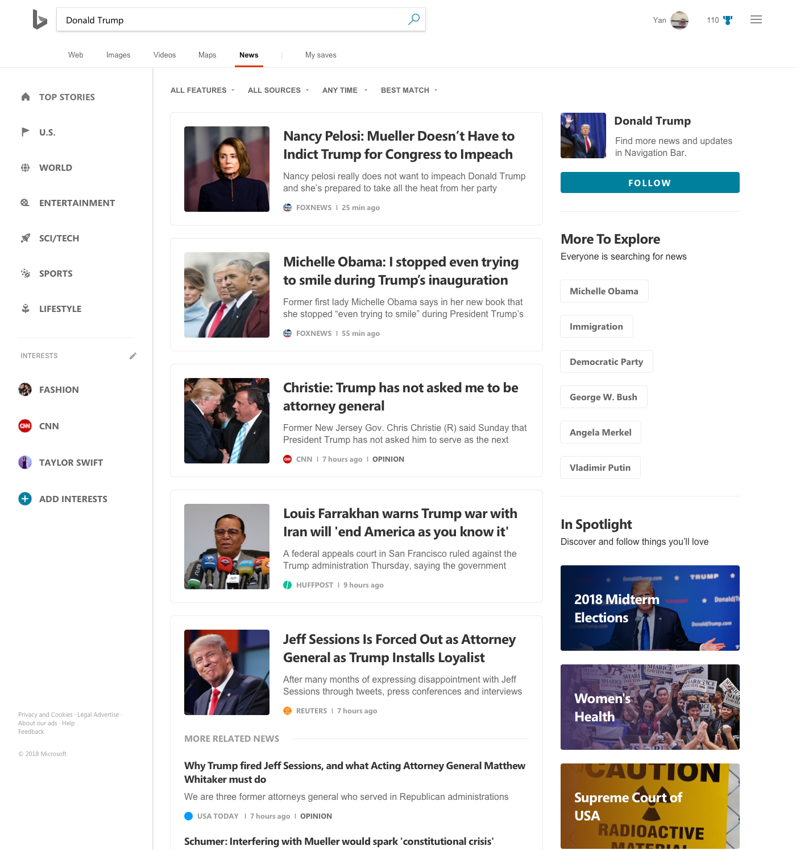
CHANGES FOR SEARCH
Better content organization
Better navigation
Better info density
Easier to follow interests/sources

Slide 47
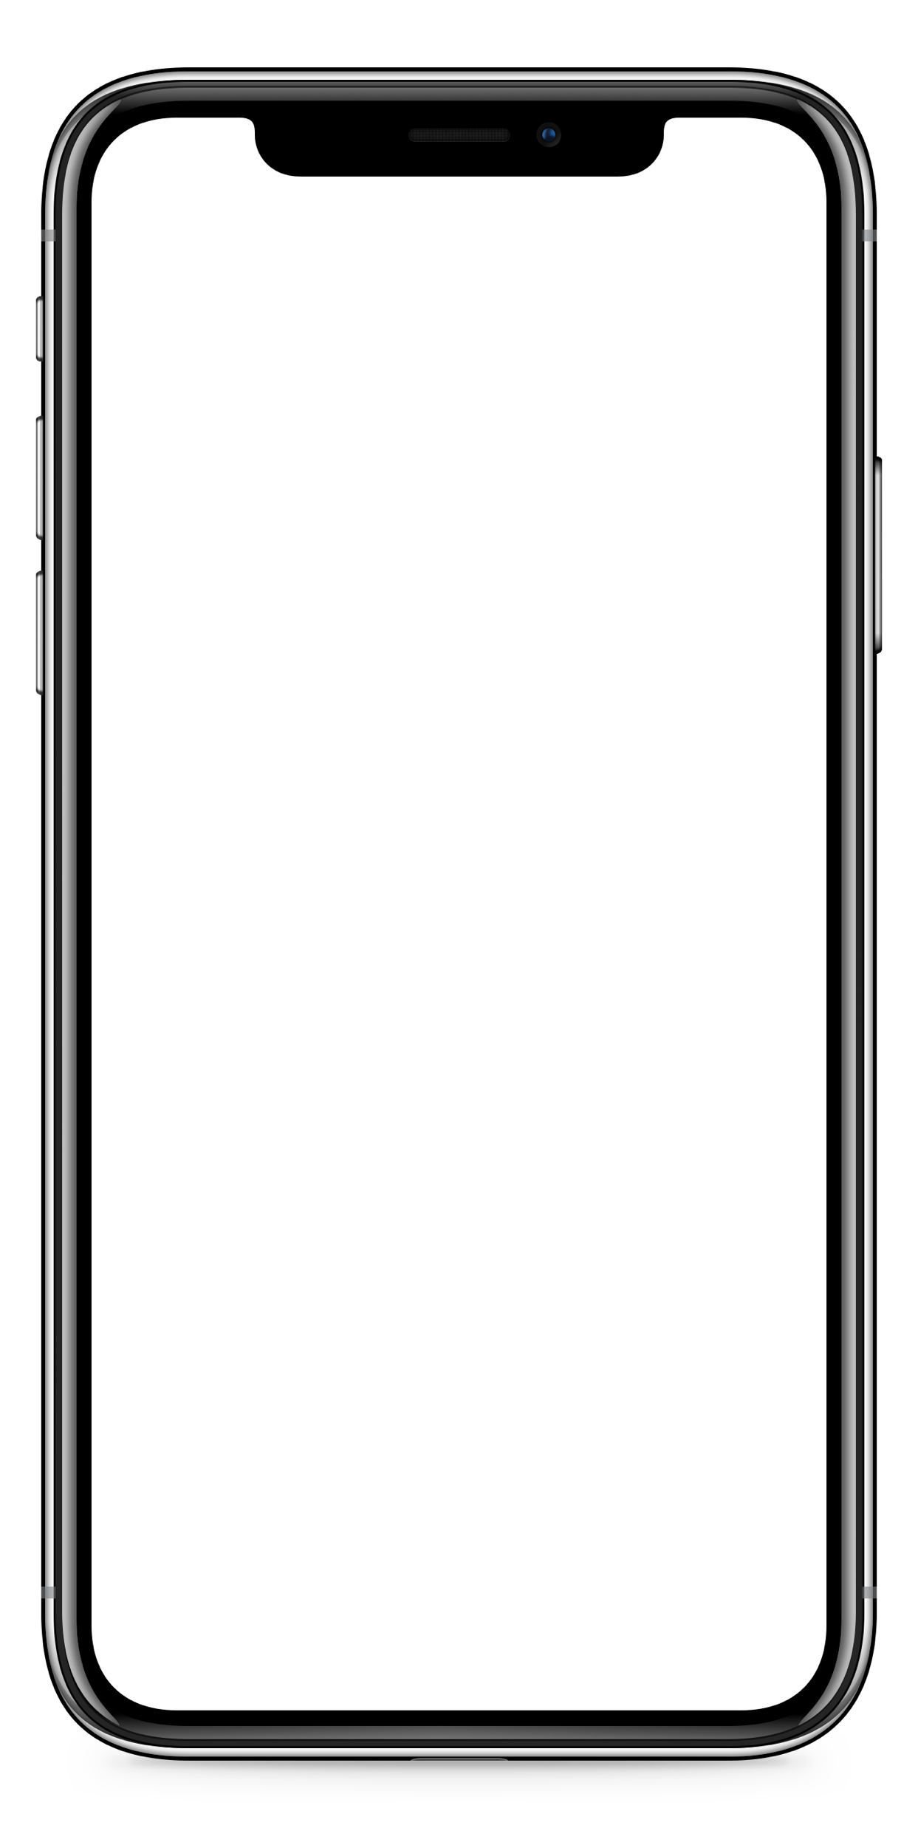
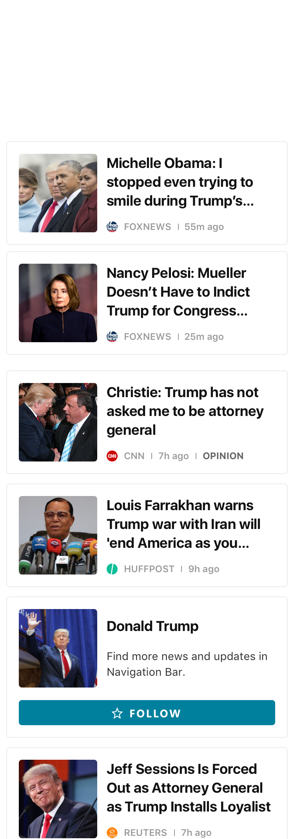

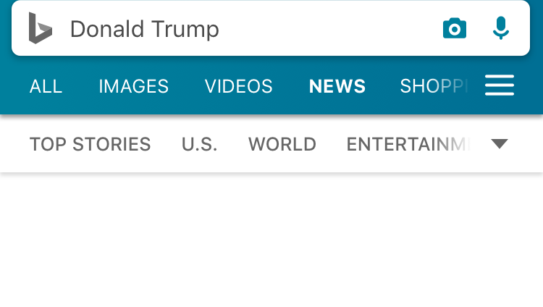

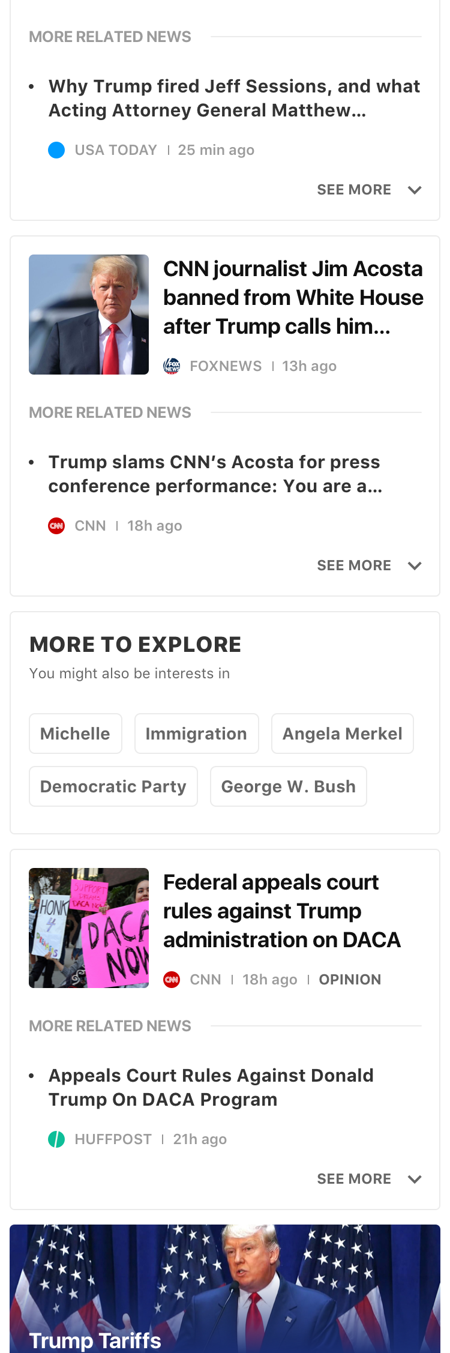
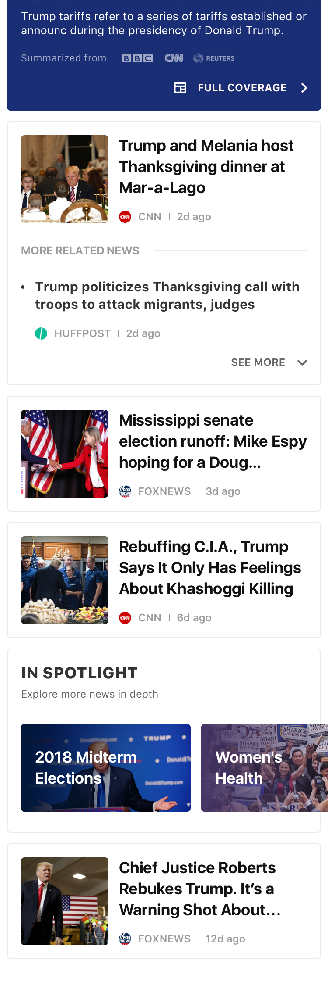
SEARCH EXPERIENCE

Slide 48
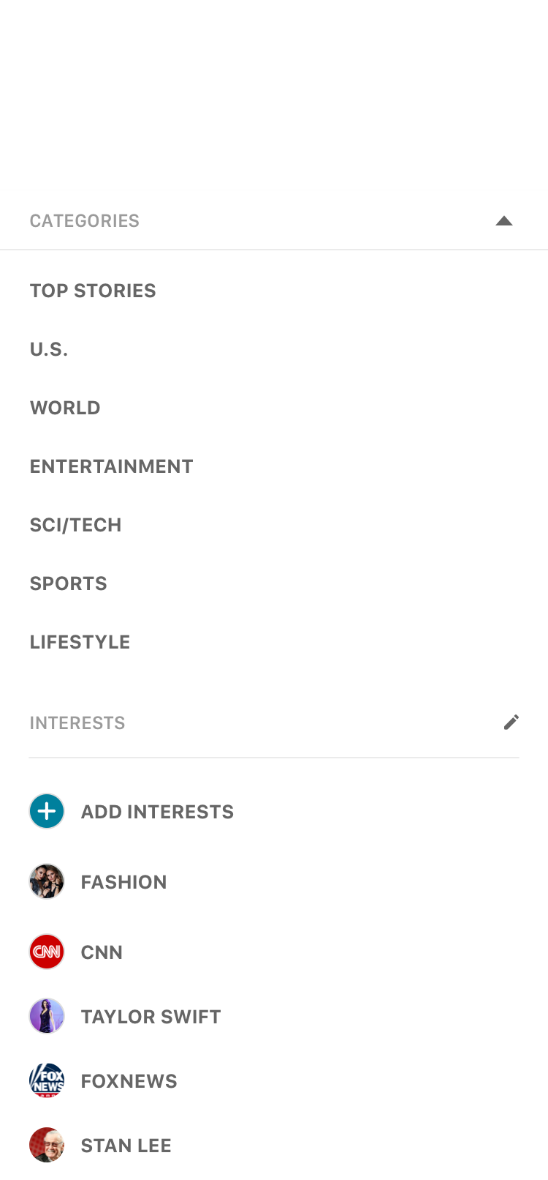
VISUAL
NAVIGATION
Big, bold font. Rich imagery
Fast & customizable navigation

Slide 49
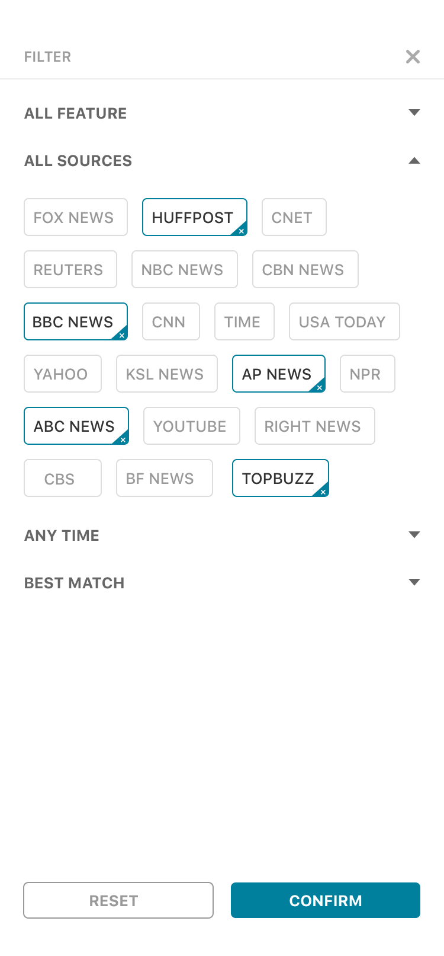
FILTER
More control on
what to read

Slide 50
More efficient way to get informed
Cluster

Slide 51
MORE TO EXPLORE
Bringing your interests closer to you and simply explore more.

Slide 52
ENTRY POINT TO COMPREHENSIVE VIEW
Easily to go-deep
Into a story

Slide 53

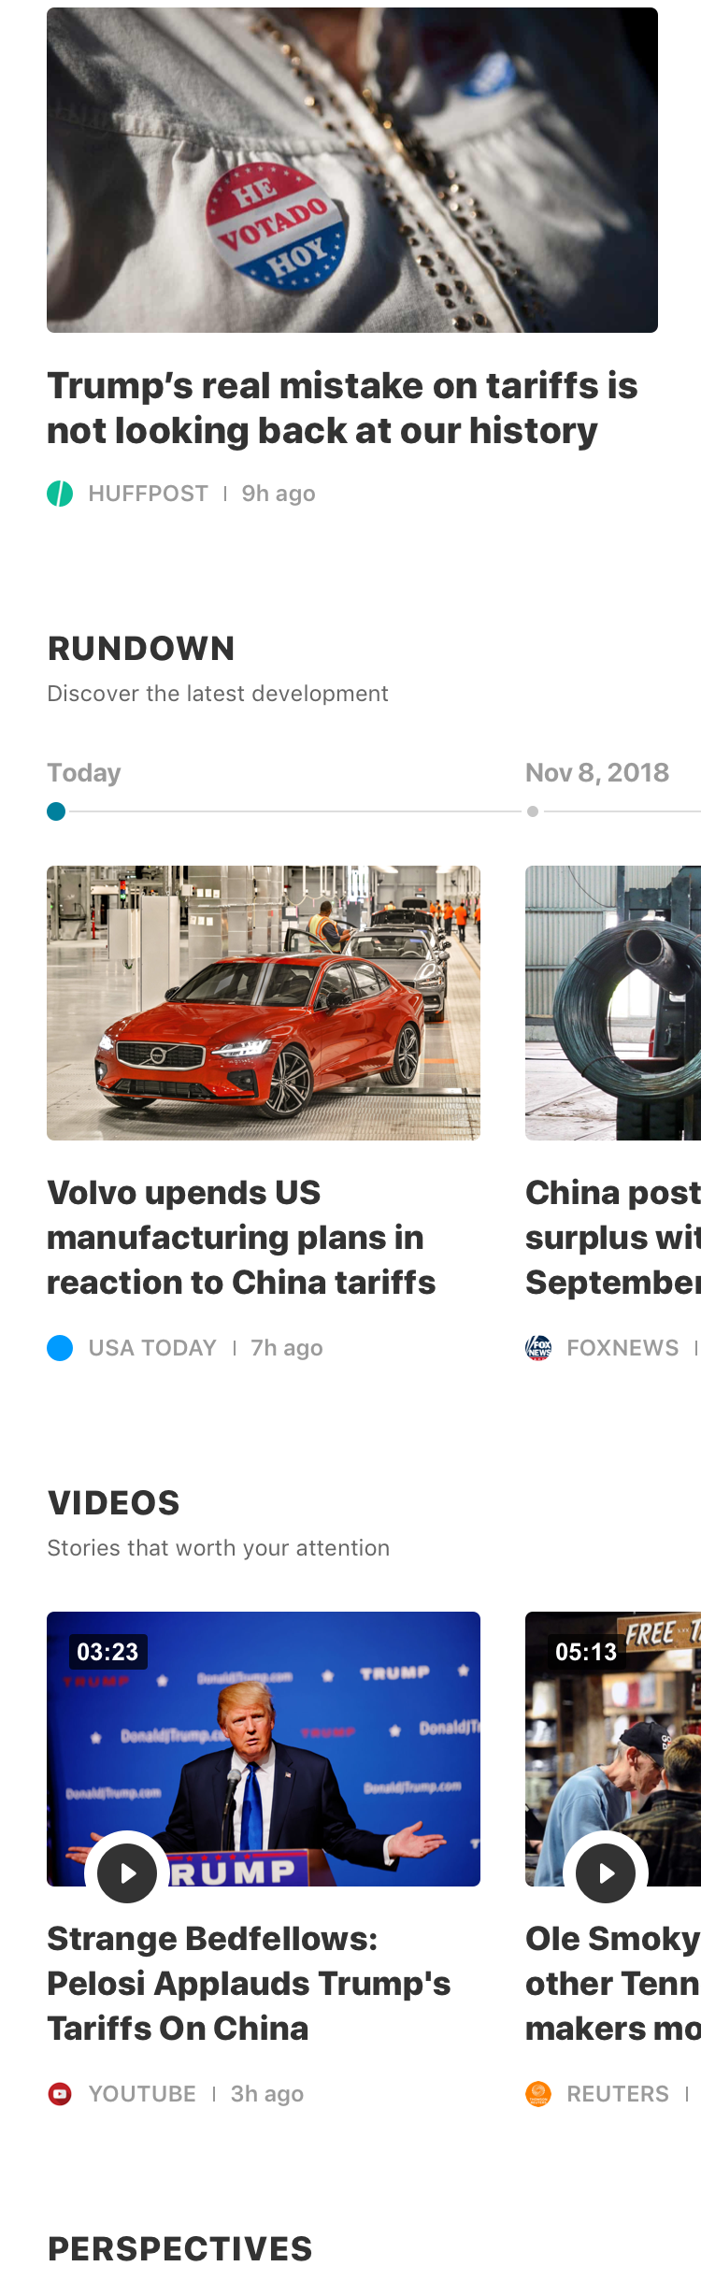


TOP HEADLINES
Prominent top stories to give reader quick overview of the event

Slide 54
Fast to get the latest development
RUNDOWN

Slide 55
Explore more news that move.
VIDEO NEWS

Slide 56
Easily get all-side’s opinions on a topic
PERSPECTIVES

Slide 57
SOCIAL
See what’s happening on twitter

Slide 58





Top Stories
BROWSE EXPERIENCE

Slide 59
TOP HEADLINES
Discover today’s headline news with related coverage

Slide 60
ORGANIZATION
Content organized by sections to give readers a quick overview on today’s top stories

Slide 61
ORGANIZATION
Content organized by sections to give readers a quick overview on today’s top stories

Slide 62
TRENDING TOPIC
Content organized by sections to give readers a quick overview on today’s top stories

Slide 63

OLD SEARCH
NEW SEARCH

Slide 64


OLD BROWSE
NEW BROWSE

Slide 65




OPTION1
Inkjet
Efficient
Immersive
Visual

Slide 66
OPTION 2
Letterpress
Efficient. Simple. Elegant

Slide 67


SEARCH EXPERIENCE
VISUAL
Big, bold font.
Simple, elegant layout.

Slide 68

SEARCH EXPERIENCE
INTERESTS
Discover and follow interests more easily

Slide 69
SEARCH EXPERIENCE

Slide 70
SEARCH EXPERIENCE
CLUSTER
More efficient way
to get informed

Slide 71
SEARCH EXPERIENCE
ENTRY POINT TO
COMPREHENSIVE VIEW
Easily to go-deep into
a story

Slide 72
SEARCH EXPERIENCE
ENTRY POINT TO
COMPREHENSIVE VIEW
Easily to go-deep into
a story

Slide 73
BROWSE EXPERIENCE
TOP HEADLINES
Prominent top stories to
Give readers a quick
overview of the event

Slide 74
BROWSE EXPERIENCE
RUNDOWN
Fast to get the latest
development
VIDEO NEWS
Explore more news that
moves

Slide 75
BROWSE EXPERIENCE
PERSPECTIVE
Easily get all-side’s opinions
On a topic
SOCIAL
See what’s happening on
Twitter

Slide 76
BROWSE EXPERIENCE
MORE NEWS
More content to explore

Slide 77




TOP STORIES
ORGANIZATION
Content organized by sections to give readers a quick overview on today’s top stories

Slide 78
TOP STORIES
ORGANIZATION
Content organized by sections to give readers a quick overview on today’s top stories

Slide 79
TOP STORIES
ORGANIZATION
Content organized by sections to give readers a quick overview on today’s top stories

Slide 80
TOP STORIES
ORGANIZATION
Content organized by sections to give readers a quick overview on today’s top stories

Slide 81
OLD SEARCH
NEW SEARCH

Slide 82

OLD BROWSE
NEW BROWSE

Slide 83




SEARCH EXPERIENCE

Slide 84
Big bold font Simple, elegant layout
VISUAL

Slide 85
CLUSTER
More efficient way to get informed

Slide 86
Bringing your interests closer to you and simply explore more.
MORE TO EXPLORE

Slide 87
ENTRY POINT TO COMPREHENSIVE VIEW
Easily to go-deep into a story

Slide 88



COMPREHENSIVE VIEW
Go deep into the topic with content
all in one place

Slide 89
RUNDOWN
More content to explore more

Slide 90
VIDEO NEWS
Explore more news that move

Slide 91
PERSPECTIVES
Easily to get all-sides opinions on a topic

Slide 92
MORE NEWS
More content to explore

Slide 93



Top Stories
BROWSE EXPERIENCE

Slide 94
TOP HEADLINES
Discover today’s headline news with related coverage

Slide 95
ORGANIZATION
Content organized by sections to give readers a quick overview on today’s top stories

Slide 96



OLD SEARCH
NEW SEARCH

Slide 97

OLD BROWSE
NEW BROWSE

Slide 98

OPTION 2
Letterpress
Efficient
Simple
Elegant

Slide 99
DESIGN Approach
DESIGN FOR EFFICIENCY
Better layout, fast and easy to read, more control.
DESIGN FOR TRUST
Better organization, cluster, clear structure
DESIGN FOR SIMPLICITY
Focused, modern, clean and simple.

Slide 100






THANKS
Doug Walston
Yan Yan
SABER ZOU
YUAN LI
XU HAN
Hongwei tang

